Slide 1
Political & External Factors
Affecting Energy Consumption

Slide 2
Political Ideology & Energy Efficiency
Democrat-Leaning
Republican-Leaning
Tend to prioritize social and environmental concerns that may lead to higher eco-energy efficiency
Ideological differences in support for investments in energy efficiency, depend on a myriad of factors that affect the current economical and environmental states
Often prioritize economic factors

Slide 3
California’s Energy Policies & Initiatives
Senate Bill 100
Inflation Reduction Act
Goal of achieving 100% carbon-free energy by 2045, and updates the state’s Renewables Portfolio Standard to ensure that by 2030 at least 60% of California’s electricity is renewable
Increased investments in state and local governments to invest in energy efficiency and grid resilience

Slide 4

California’s Energy Policies & Initiatives
Energy Systems Infrastructure Planning
California Energy Commission
California is transitioning its electricity system to rely increasingly on clean energy sources like solar, wind, and geothermal power as the core part of this
Implemented energy efficiency standards for buildings and appliances and offers incentives and rebates for energy-efficient upgrades

Slide 5
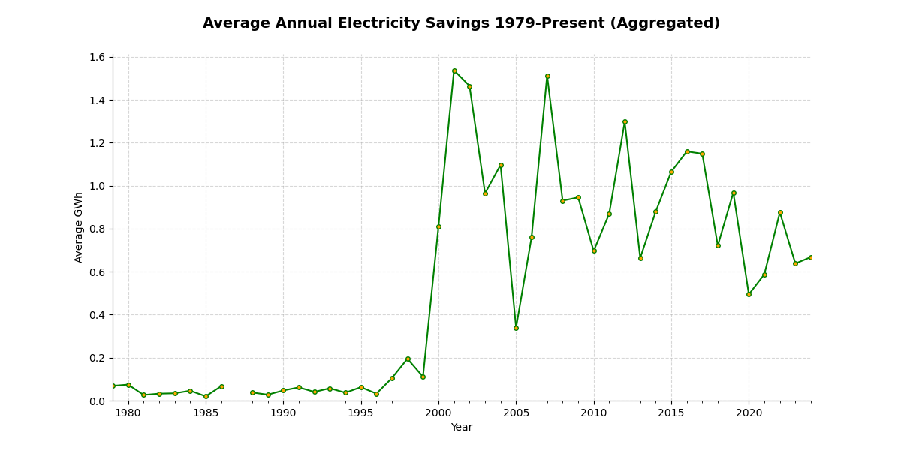
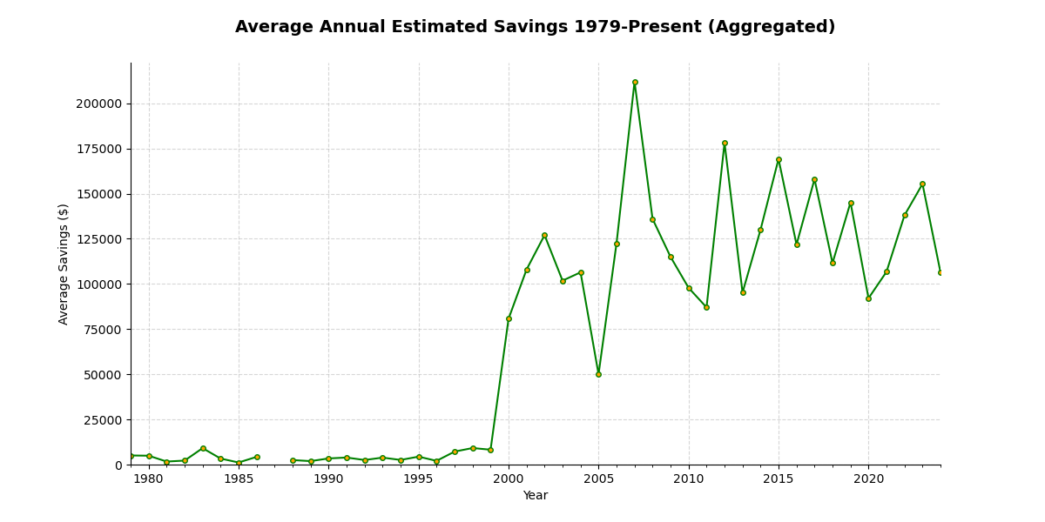
Energy Conservation Assistance Act
Average Energy Savings (kWh) | Total Energy Savings (kWh)
470,169 | 434,906,781
Average Estimated Savings ($) | Total Estimated Savings ($)
$53,429.47 | $49,368,827.08

Slide 6
Impact of Clean Energy Transition
Expected to increase electricity consumption but is accompanied by efforts to strengthen the power grid and promote energy efficiency
Investments in renewable energy technologies, such as solar and wind power, are projected to reduce energy costs over time
EV Policies aim to reduce greenhouse emissions from transportation and alleviate strain on the electricity grid
As more people replace their gas-powered vehicles with EV’s, electricity usage is expected to increase

Slide 7
Significant Legislation and Programs
Inflation Reduction Act
SB 100
SB 1020
DOE Title 17 Clean Energy Financing Program
Renewables Portfolio Standard

Slide 8
California’s Energy Grid Advancements
Complement Renewable Energy
Battery Storage Infrastructure
Load Flexibility
Today’s fleet of storage resources can capture enough electricity to power up to 5 million California homes.
Investments have been made to accompany the energy grid, with planned expansions by 2026
Practice of adjusting energy usage to match the supply of electricity.

Slide 9
Effectiveness of Energy Efficiency Programs
The Jevons Paradox may be at play, where efficiency gains lead to increased consumption, potentially undermining the intended energy-saving benefits.
Despite substantial spending on energy-efficient appliance programs, many have not resulted in energy savings and some have even increased energy consumption

Slide 10
Decarbonization Challenges & Opportunities
Natural Gas to Electric Heating
Technological Advancements
Water Heating
Could substantially reduce emissions in California's building sector but will increase electricity consumption
Energy-efficient structural design and power stability for critical facilities are emerging trends in California.
Energy-intensive element, comprising fully 1/4 of total residential energy use, improving water-heating efficiency could significantly decrease California’s overall energy usage

Slide 11
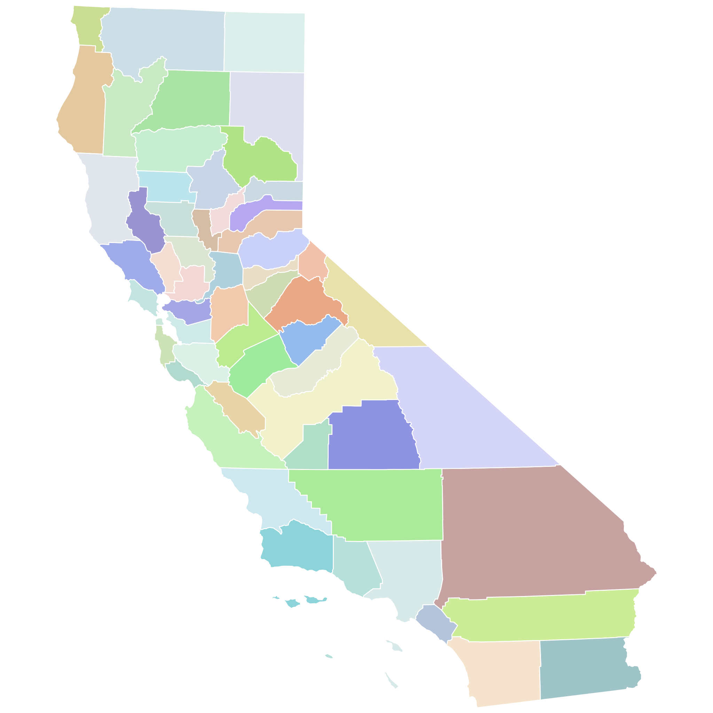
Future Energy Strategies & Goals
California aims for carbon neutrality by 2045, necessitating bold actions and policy initiatives that lead to a 100% clean grid and build more renewable sources to reduce pollution, mitigate climate change impacts, and stabilize energy costs
Load flexibility, energy storage, and additional renewable resources are essential for meeting electricity demand, especially as solar power generation fluctuates

Slide 12
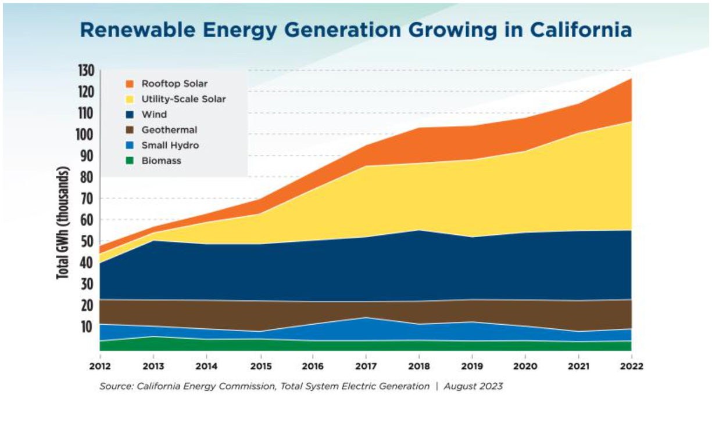
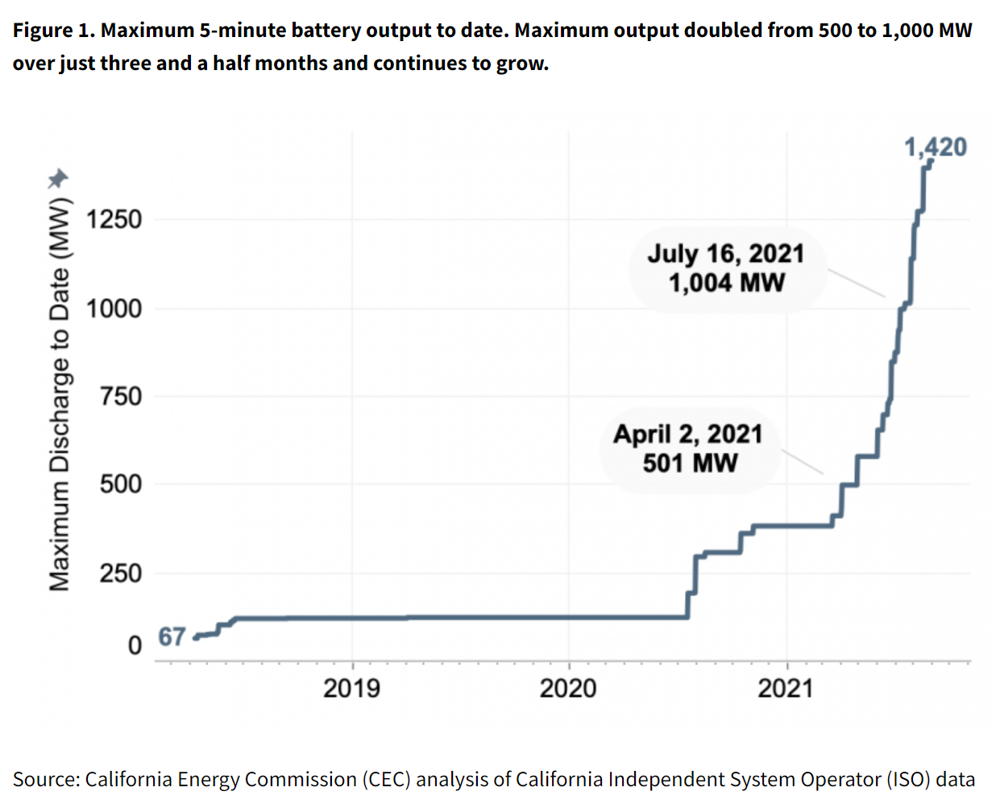

Slide 13
Forecasting Models

Slide 14
Political Ideology & Energy Efficiency
Democrat-Leaning
Republican-Leaning
Tend to prioritize social and environmental concerns that may lead to higher eco-energy efficiency
Ideological differences in support for investments in energy efficiency, depend on a myriad of factors that affect the current economical and environmental states
Often prioritize economic factors

Slide 15
California’s Energy Policies & Initiatives
Senate Bill 100
Inflation Reduction Act
Goal of achieving 100% carbon-free energy by 2045, and updates the state’s Renewables Portfolio Standard to ensure that by 2030 at least 60% of California’s electricity is renewable
Increased investments in state and local governments to invest in energy efficiency and grid resilience

Slide 16
California’s Energy Policies & Initiatives
Energy Systems Infrastructure Planning
California Energy Commission
California is transitioning its electricity system to rely increasingly on clean energy sources like solar, wind, and geothermal power as the core part of this
Implemented energy efficiency standards for buildings and appliances and offers incentives and rebates for energy-efficient upgrades

Slide 17
Energy Conservation Assistance Act
Average Energy Savings (kWh) | Total Energy Savings (kWh)
470,169 | 434,906,781
Average Estimated Savings ($) | Total Estimated Savings ($)
$53,429.47 | $49,368,827.08

Slide 18
Impact of Clean Energy Transition
Expected to increase electricity consumption but is accompanied by efforts to strengthen the power grid and promote energy efficiency
Investments in renewable energy technologies, such as solar and wind power, are projected to reduce energy costs over time
EV Policies aim to reduce greenhouse emissions from transportation and alleviate strain on the electricity grid
As more people replace their gas-powered vehicles with EV’s, electricity usage is expected to increase

Slide 19
Significant Legislation and Programs
Inflation Reduction Act
SB 100
SB 1020
DOE Title 17 Clean Energy Financing Program
Renewables Portfolio Standard

Slide 20
California’s Energy Grid Advancements
Complement Renewable Energy
Battery Storage Infrastructure
Load Flexibility
Today’s fleet of storage resources can capture enough electricity to power up to 5 million California homes.
Investments have been made to accompany the energy grid, with planned expansions by 2026
Practice of adjusting energy usage to match the supply of electricity.

Slide 21
Effectiveness of Energy Efficiency Programs
The Jevons Paradox may be at play, where efficiency gains lead to increased consumption, potentially undermining the intended energy-saving benefits.
Despite substantial spending on energy-efficient appliance programs, many have not resulted in energy savings and some have even increased energy consumption

Slide 22
Decarbonization Challenges & Opportunities
Natural Gas to Electric Heating
Technological Advancements
Water Heating
Could substantially reduce emissions in California's building sector but will increase electricity consumption
Energy-efficient structural design and power stability for critical facilities are emerging trends in California.
Energy-intensive element, comprising fully 1/4 of total residential energy use, improving water-heating efficiency could significantly decrease California’s overall energy usage

Slide 23
Future Energy Strategies & Goals
California aims for carbon neutrality by 2045, necessitating bold actions and policy initiatives that lead to a 100% clean grid and build more renewable sources to reduce pollution, mitigate climate change impacts, and stabilize energy costs
Load flexibility, energy storage, and additional renewable resources are essential for meeting electricity demand, especially as solar power generation fluctuates

Slide 25
Forecasting Models

Slide 26
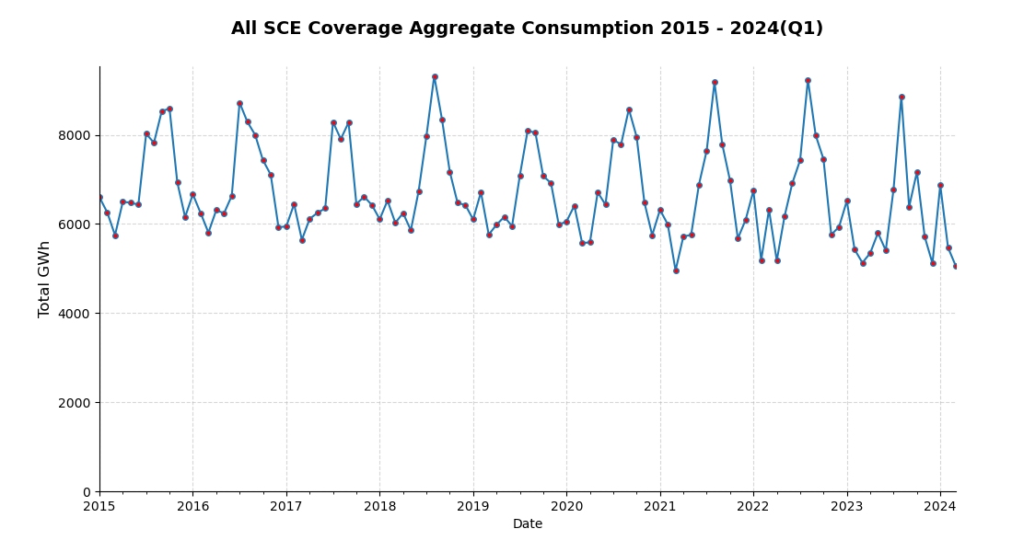
Let’s Take A Look At The Past…
Data Source: SCE Quarterly Energy Data Reports

Slide 27
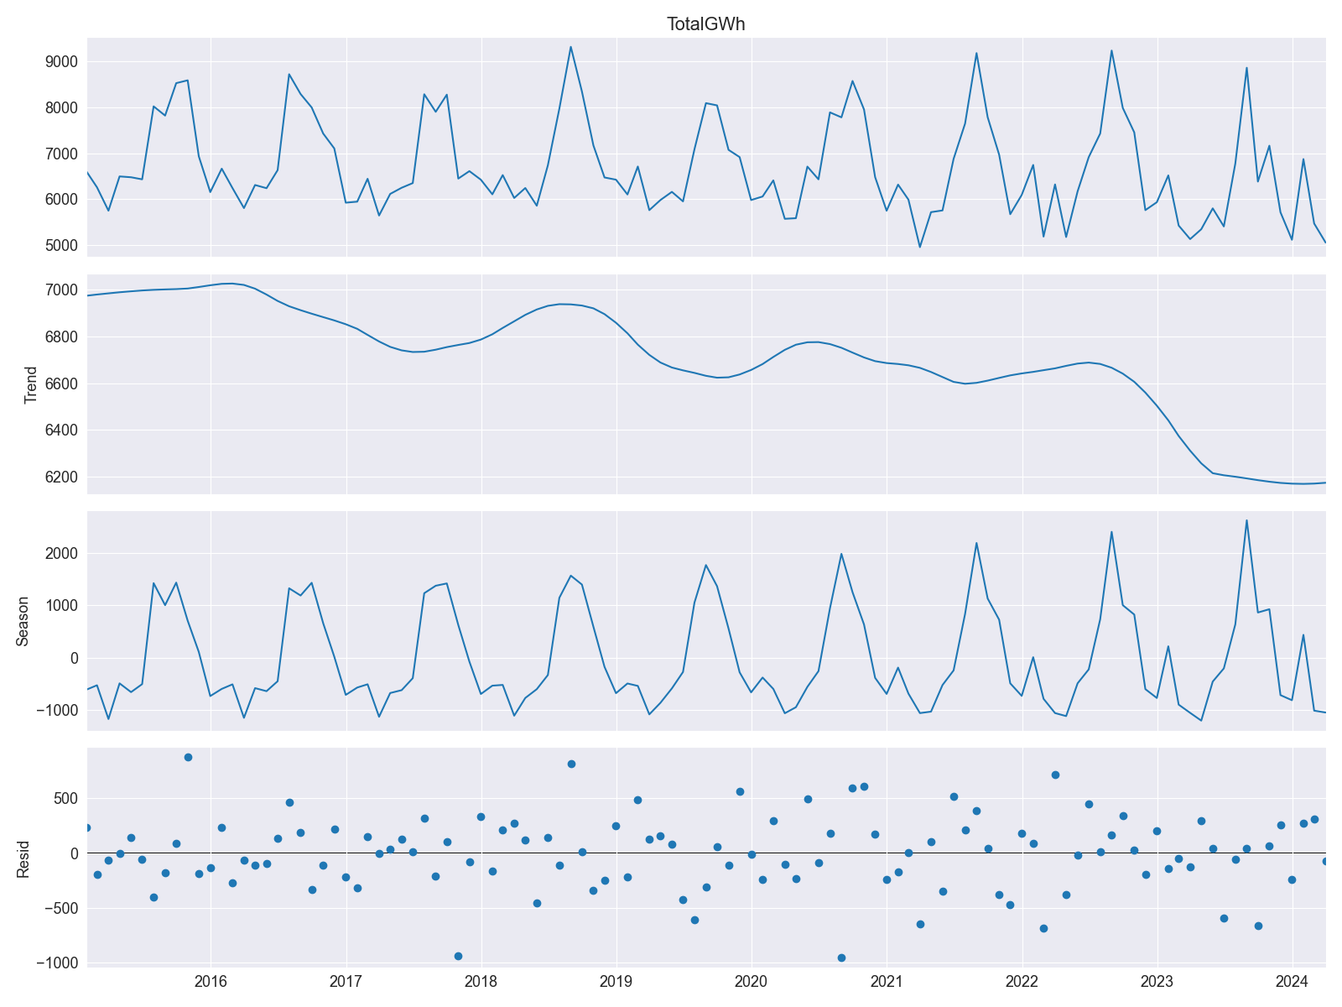
Time-Decomposition

Slide 28
SARIMAX
Seasonal Autoregressive Integrated Moving Average
with Exogenous Regressors
A statistical model designed to capture and forecast the underlying patterns, trends and seasonality in time-series data.
A powerful time series forecasting technique that extends the traditional ARIMA model to account for seasonality and external factors.

Slide 29
Components
Seasonal (S) | Periodic patterns in data (weekly, monthly, annually, e.g.)
Autoregressive (AR) | Represents relationship between current and previous values in the data
Integrated (I) | Differencing to make data stationary by removing trends and seasonality
Moving Average (MA) | Accounts for dependency of current value on past error terms, used to calculate trend
Exogenous Regressors (X) | Allows inclusion of external factors that may affect data

Slide 30
SARIMAX Parameters
p
d
q
P
D
Q
s/m
Autoregressive Order
Differencing Order
Moving Average Order
Seasonal Autoregressive Order
Seasonal Differencing Order
Seasonal Moving Average Order
Seasonal Period

Slide 31
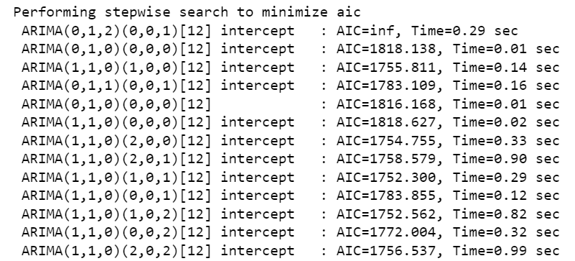
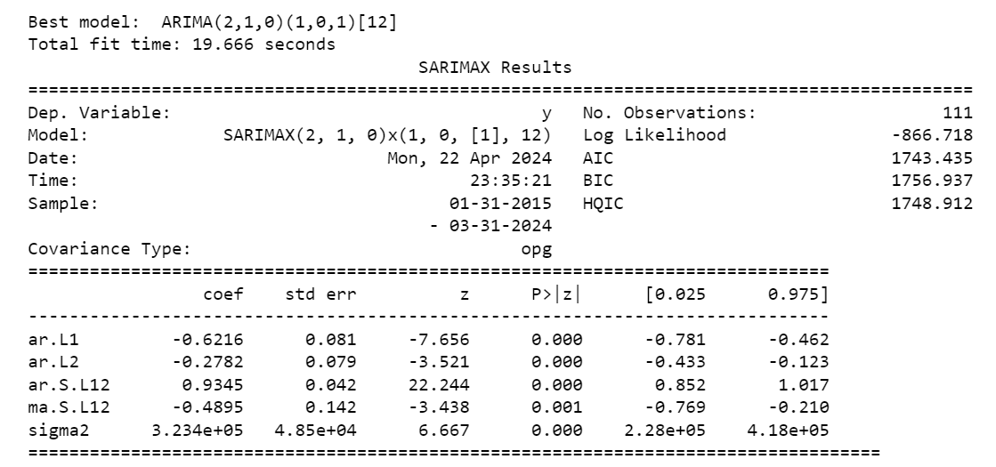
AutoArima To Find Optimal Model Parameters

Slide 32
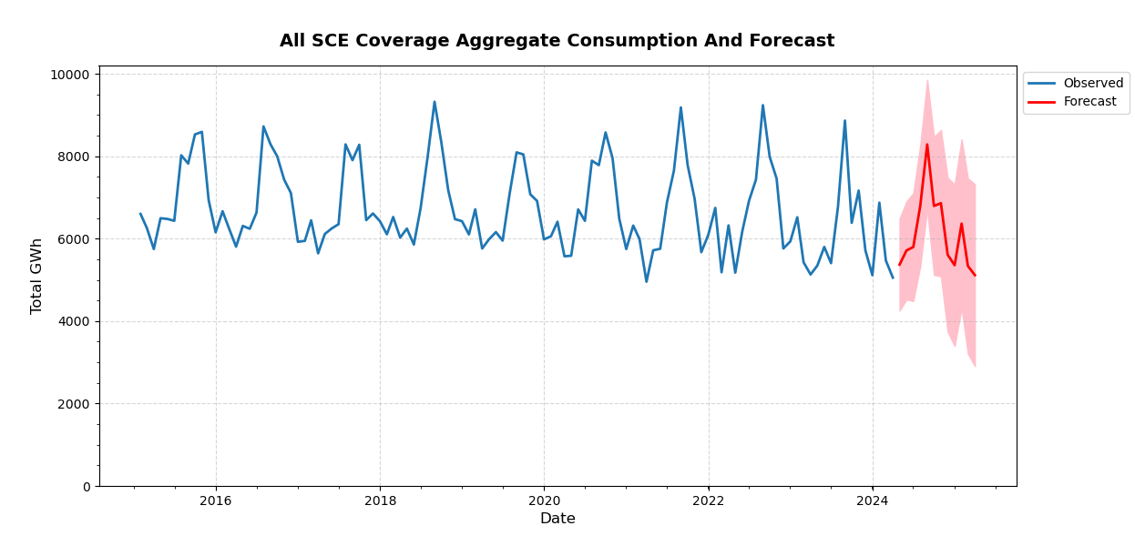
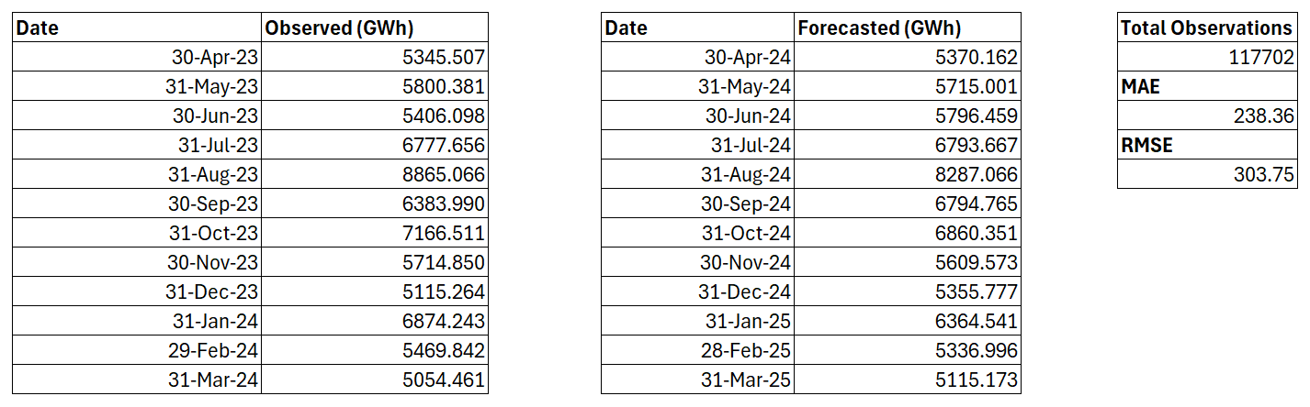
Total Observed | 73,973.87
Total Forecasted | 73,399.53
Difference | - 0.78 %

Slide 33
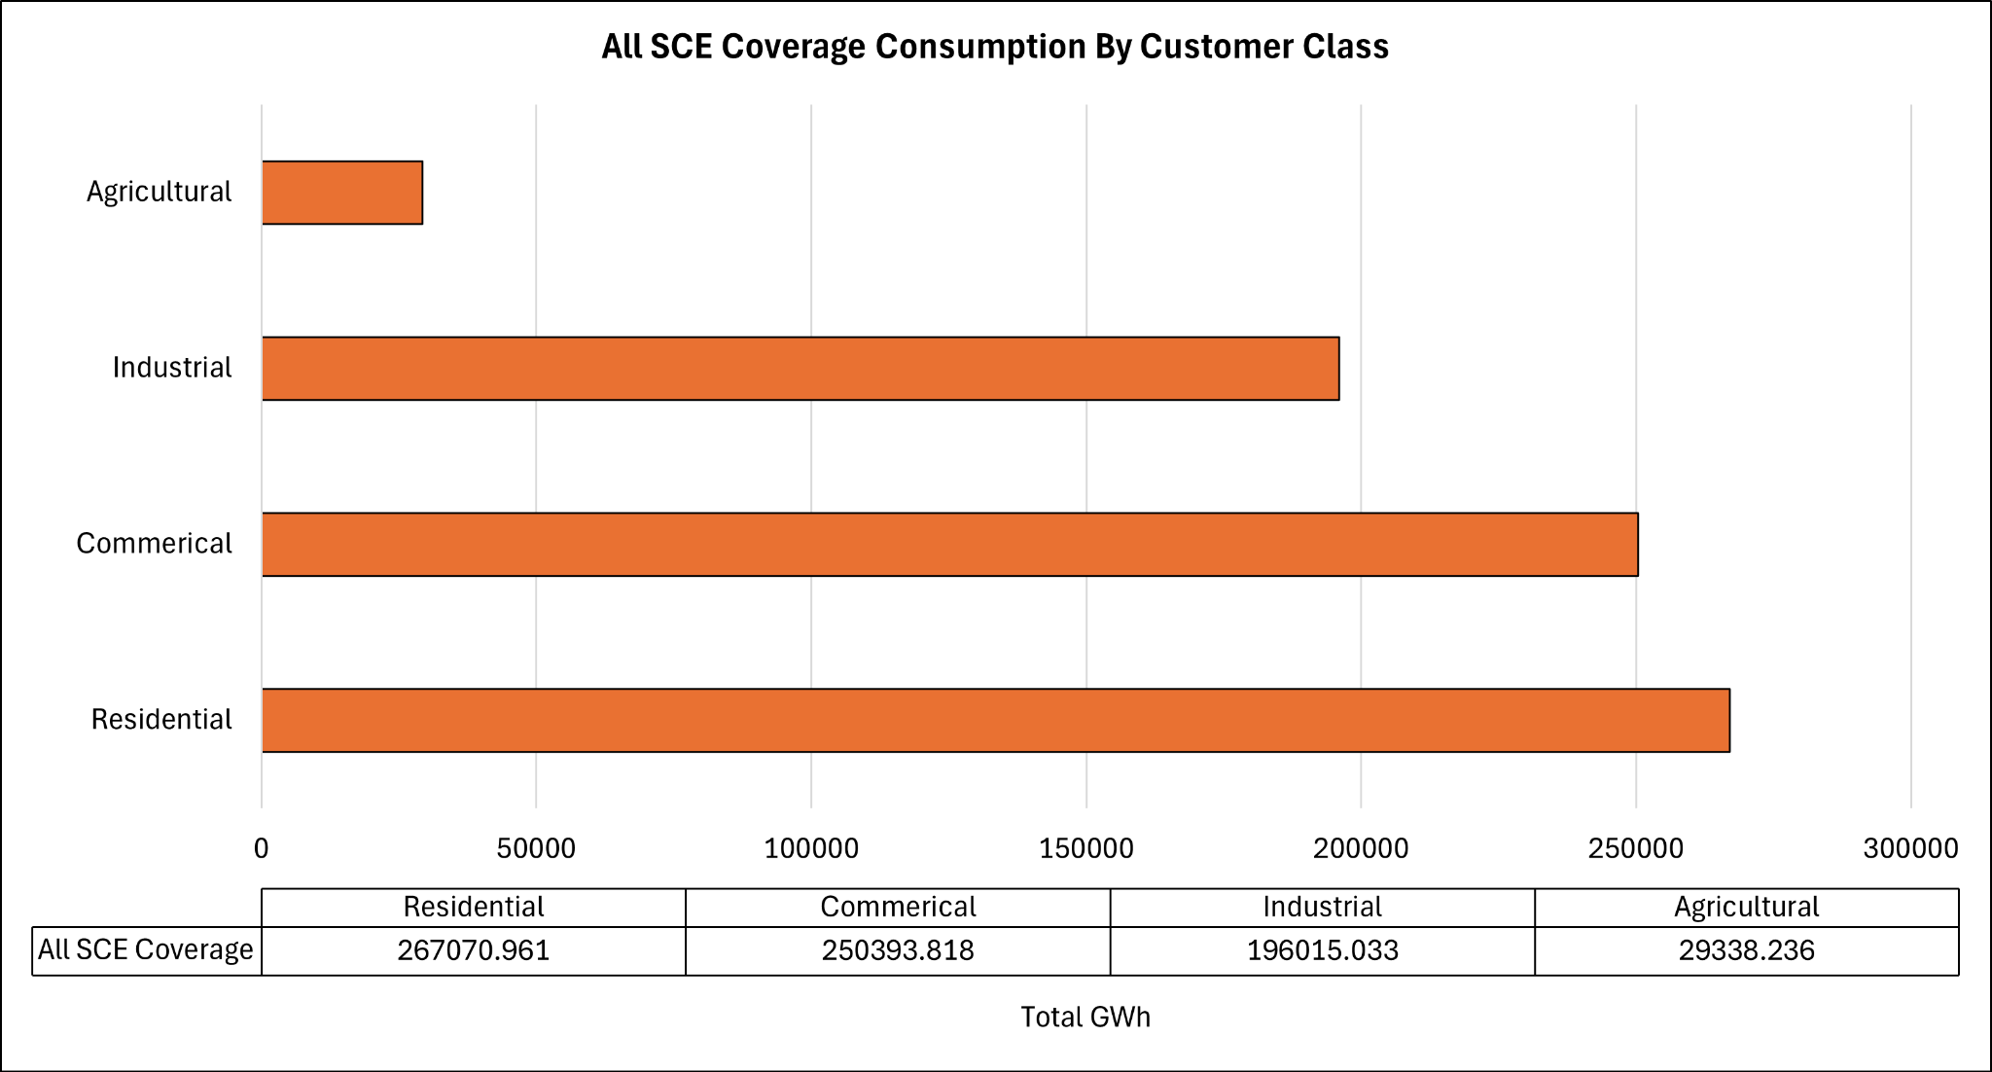

Slide 34
County Forecasts
Predicted Consumptions with Error Values
Projected Percentage Change Based On Forecasted Period

Slide 35
Zip Codes
Counties
Mapped + Grouped to their associated Counties
Data Source: California ZIP Codes List, Map, and Demographics (unitedstateszipcodes.org)

Slide 36
Counties With A Projected Usage Increase

Slide 37
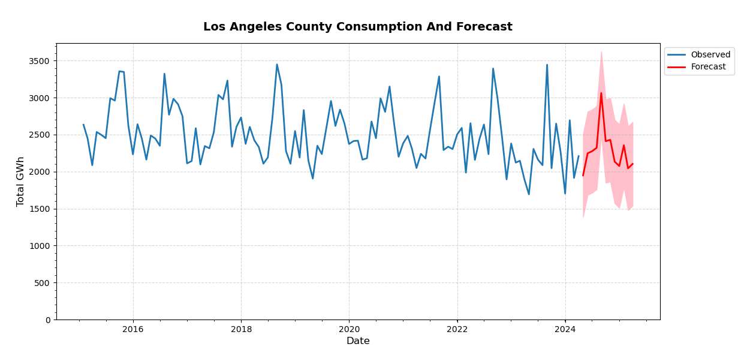
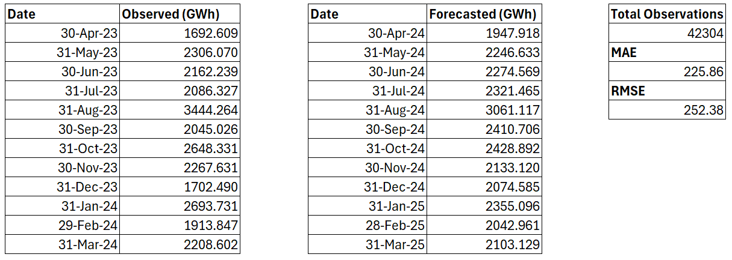
Total Observed | 27,171.17
Total Forecasted | 27,400.190
Difference | 0.84 %

Slide 38
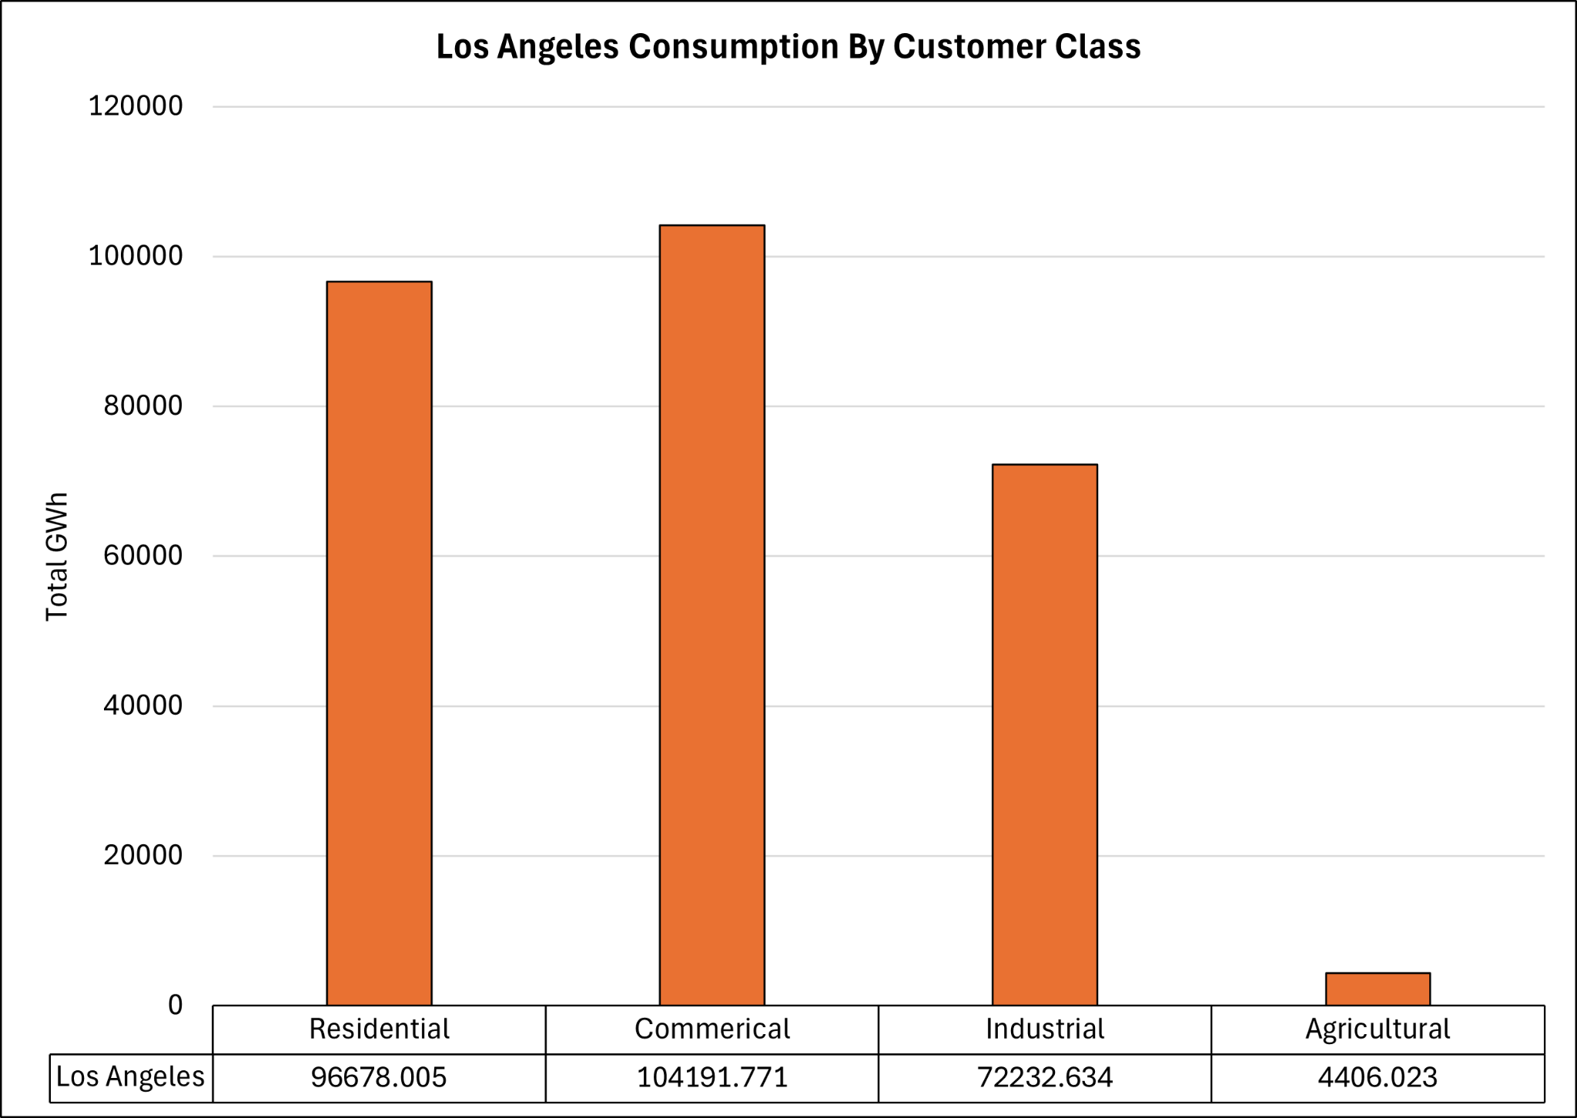

Slide 39
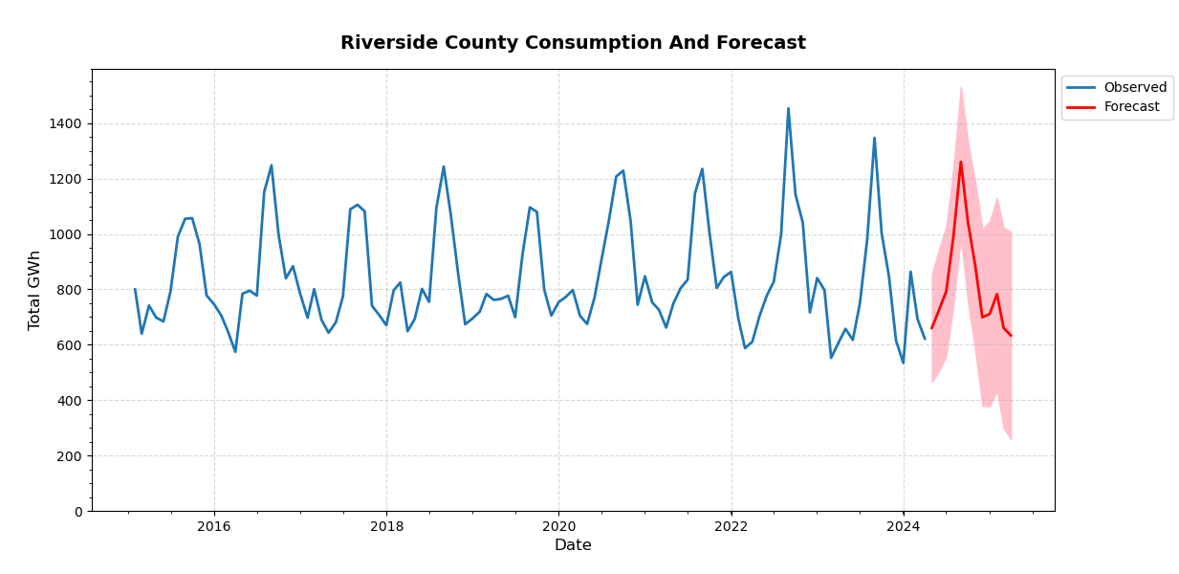
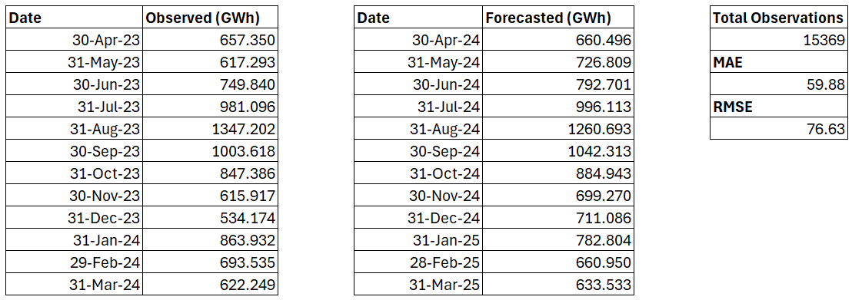
Total Observed | 9,533.59
Total Forecasted | 9,851.71
Difference | 3.34 %

Slide 40
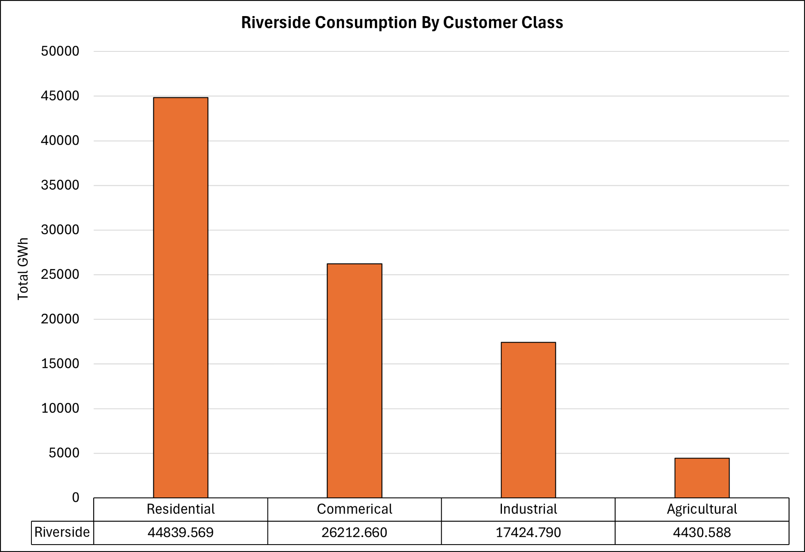

Slide 41
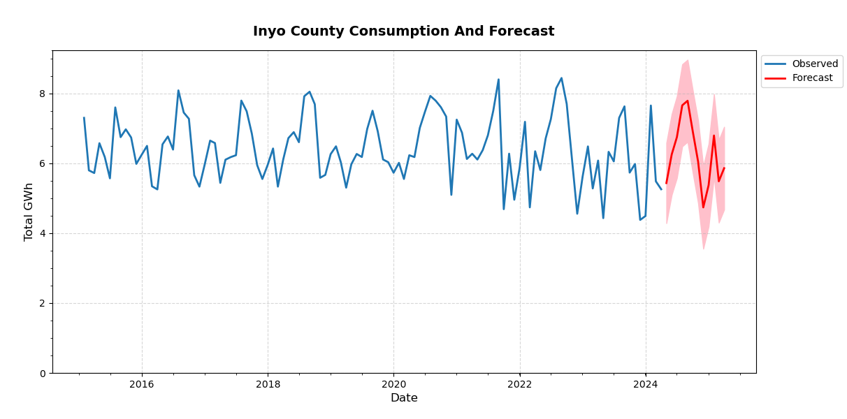
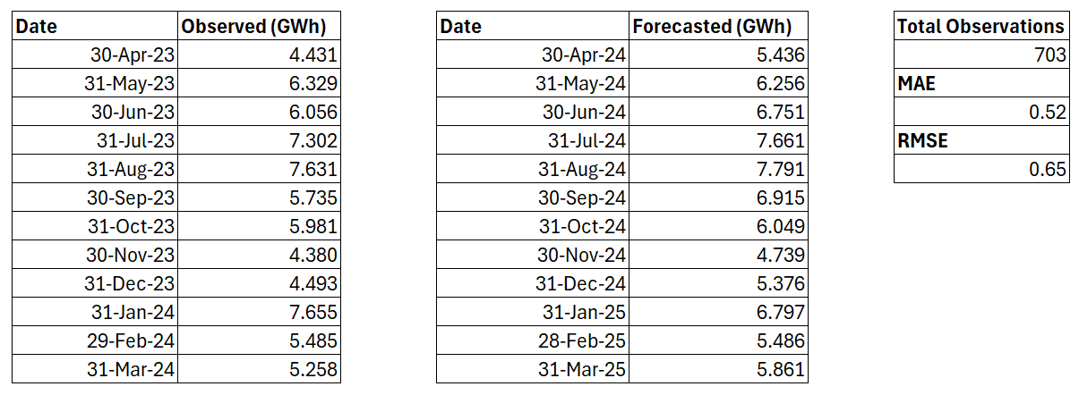
Total Observed | 70.74
Total Forecasted | 75.12
Difference | 6.19 %

Slide 42
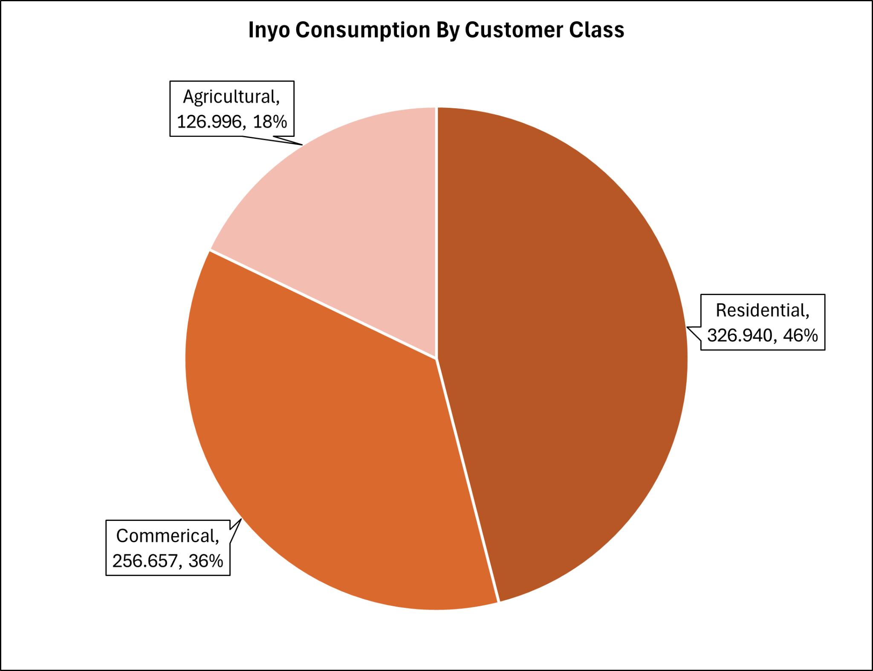

Slide 43
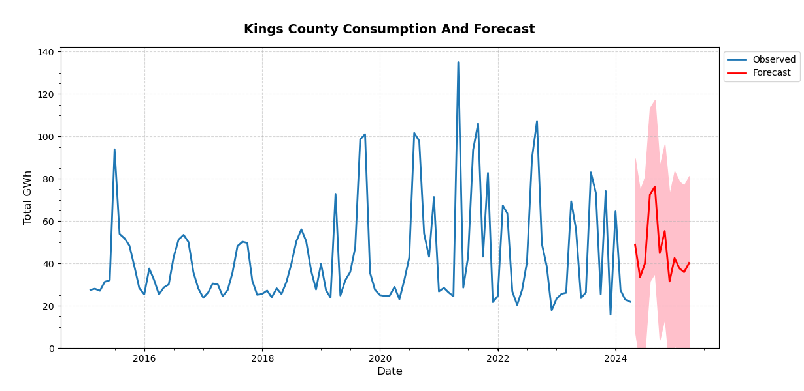
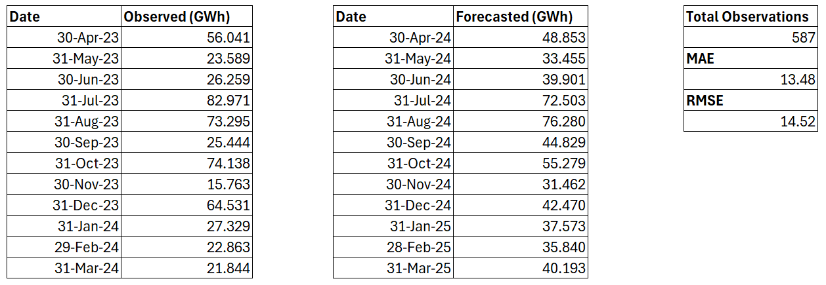
Total Observed | 514.07
Total Forecasted | 558.64
Difference | 8.67 %

Slide 44
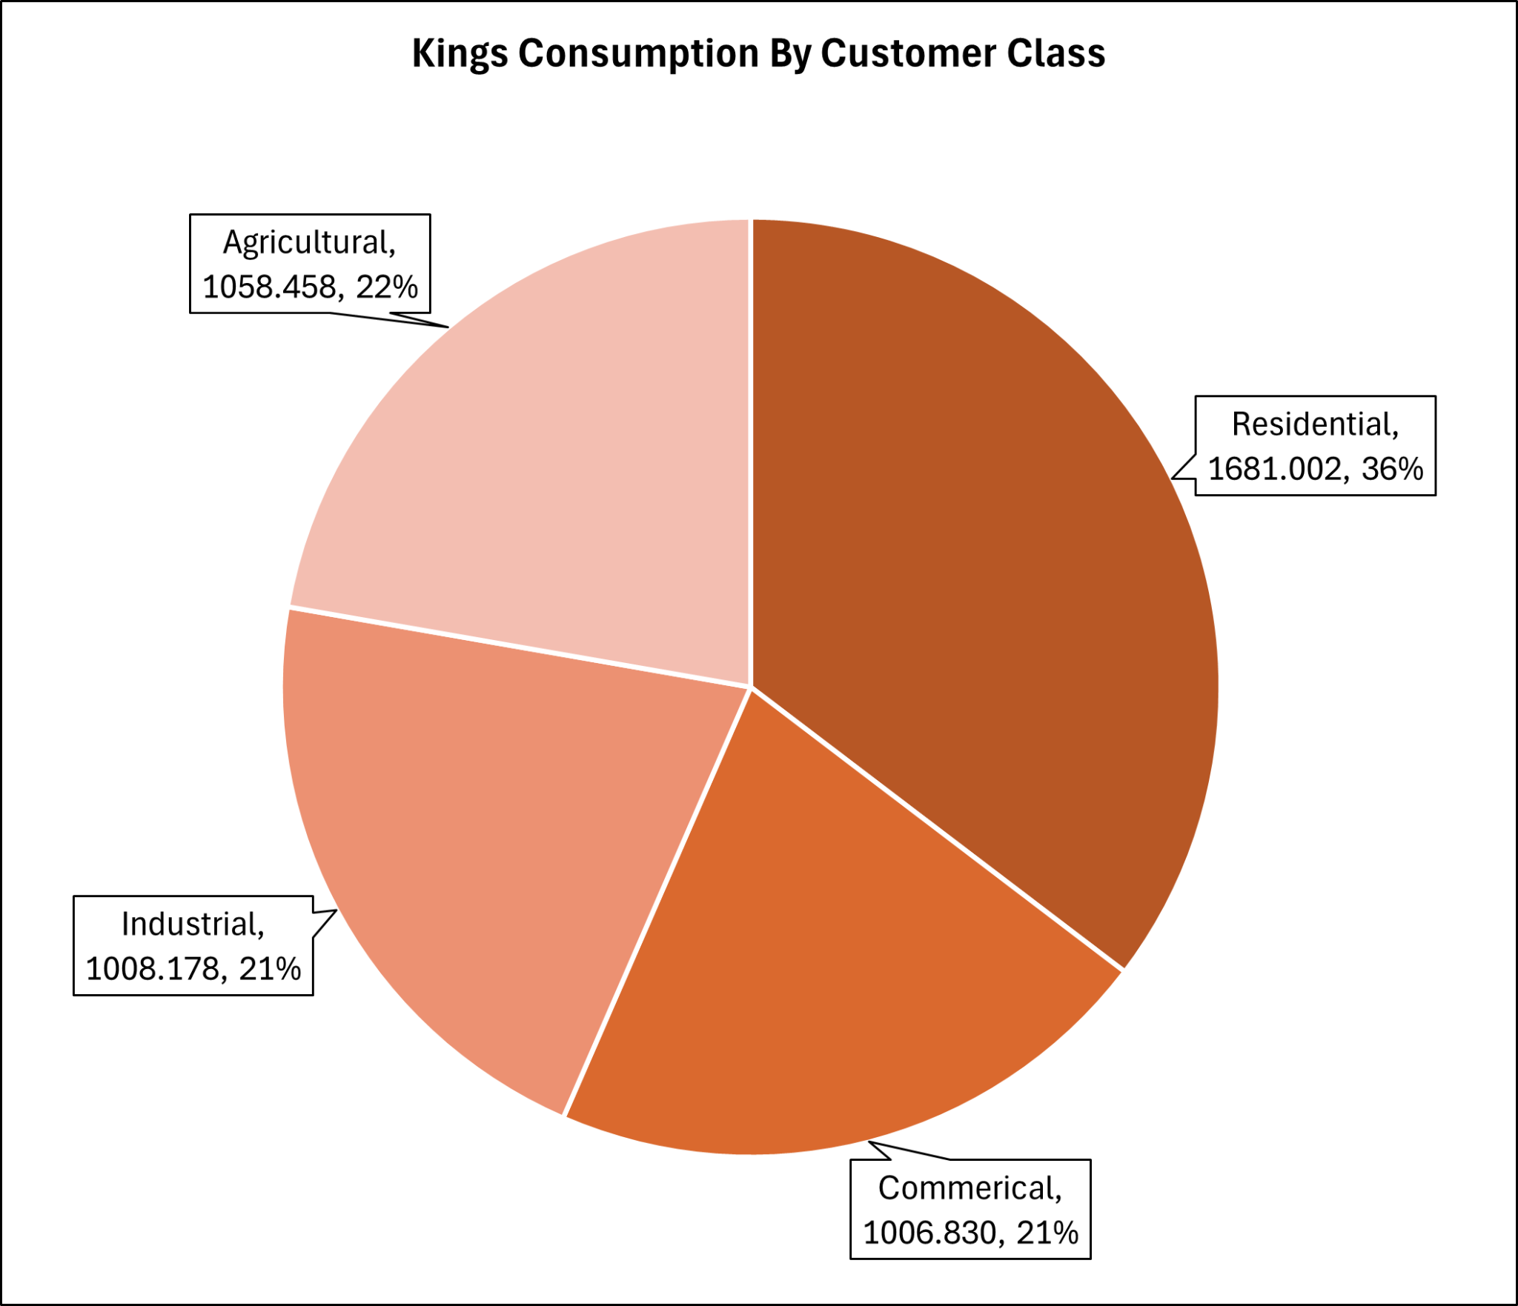

Slide 45
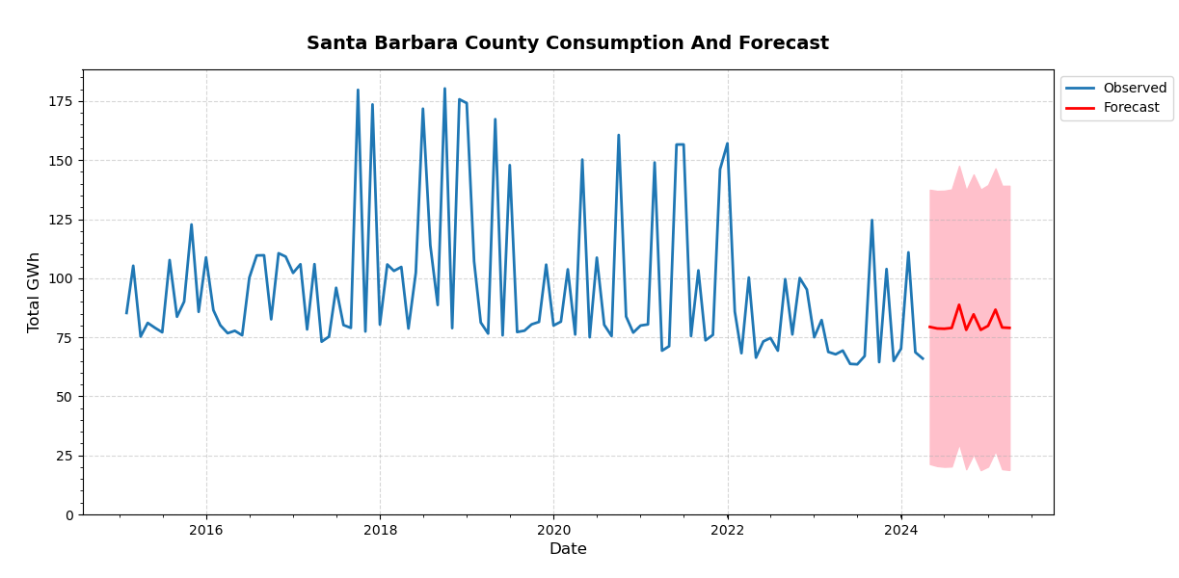
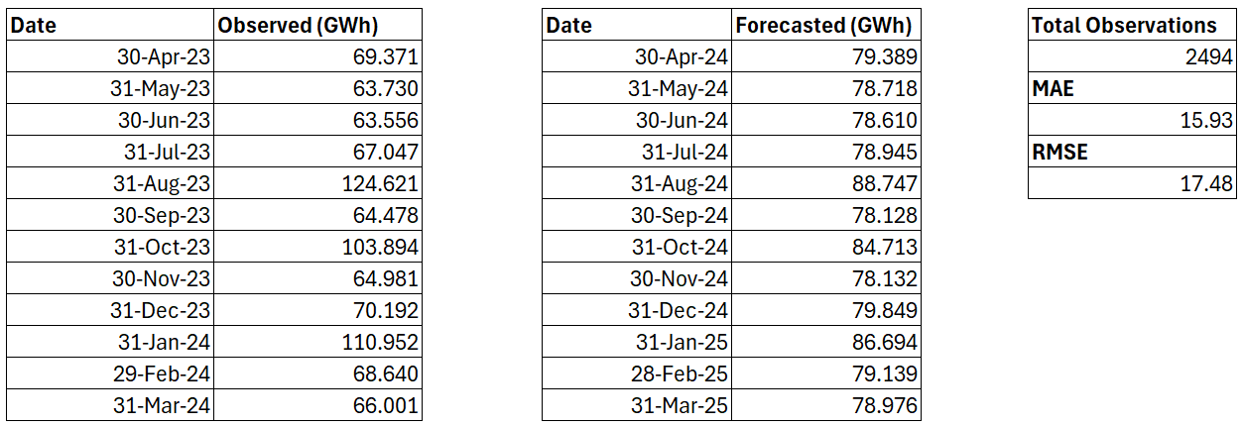
Total Observed | 937.46
Total Forecasted | 970.04
Difference | 3.47 %

Slide 46
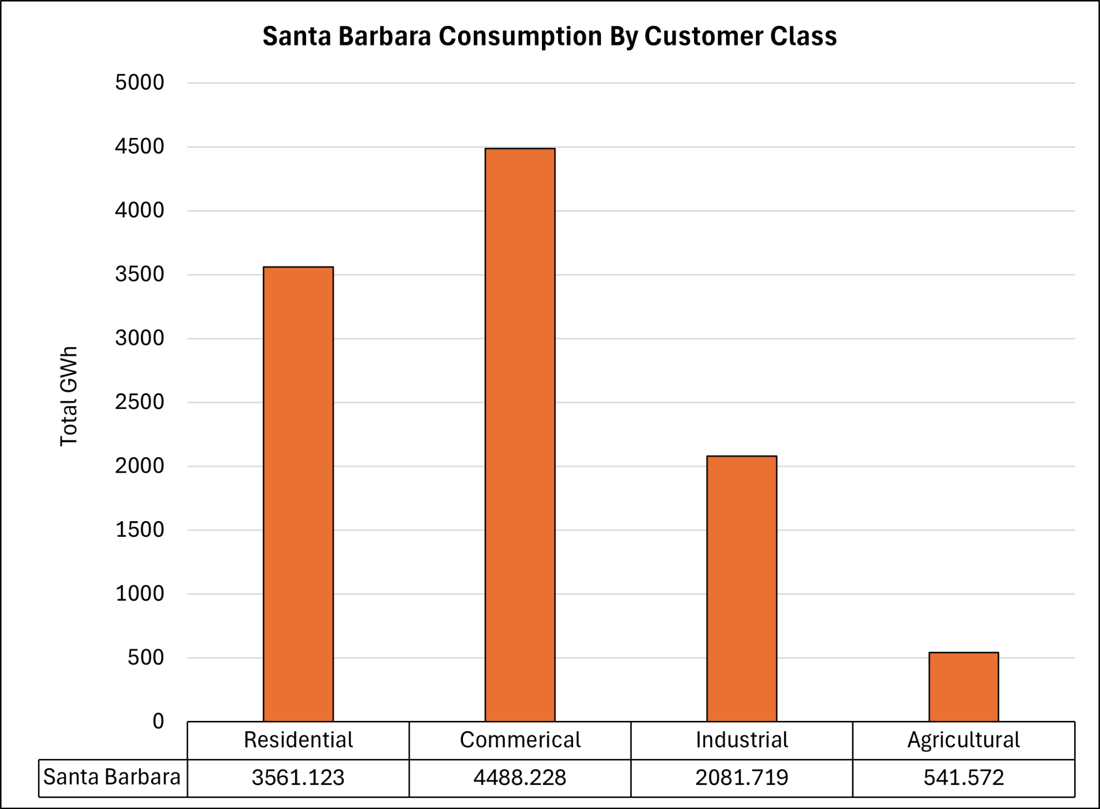

Slide 47
Counties With A Projected Usage Decrease

Slide 48
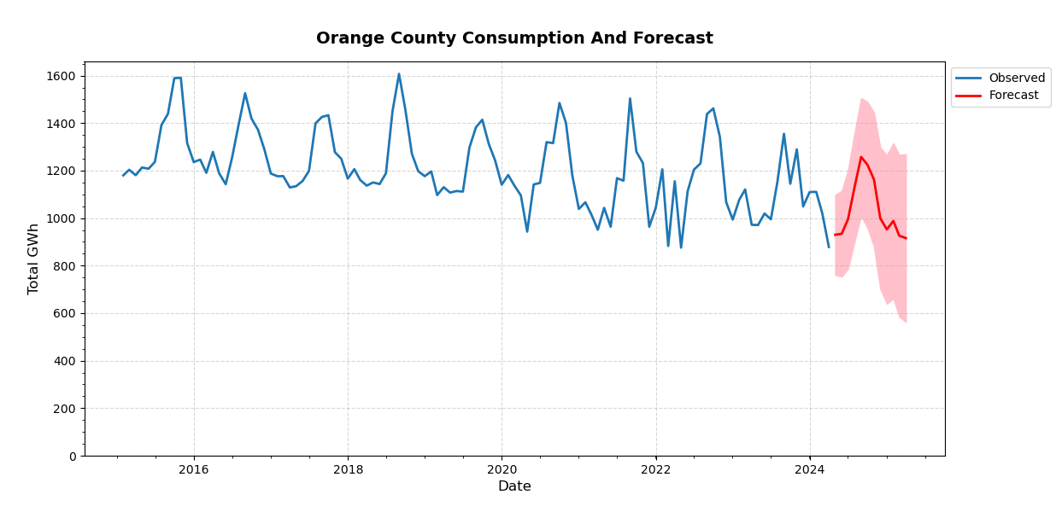
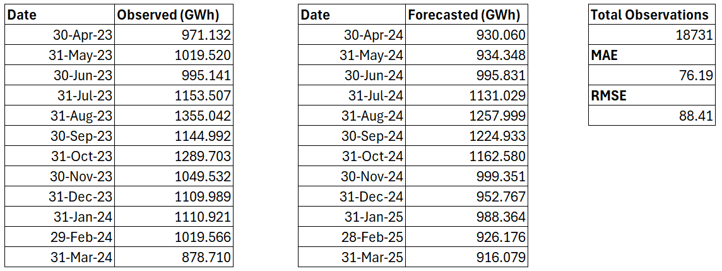
Total Observed | 13,097.75
Total Forecasted | 12,419.52
Difference | - 5.18 %

Slide 49
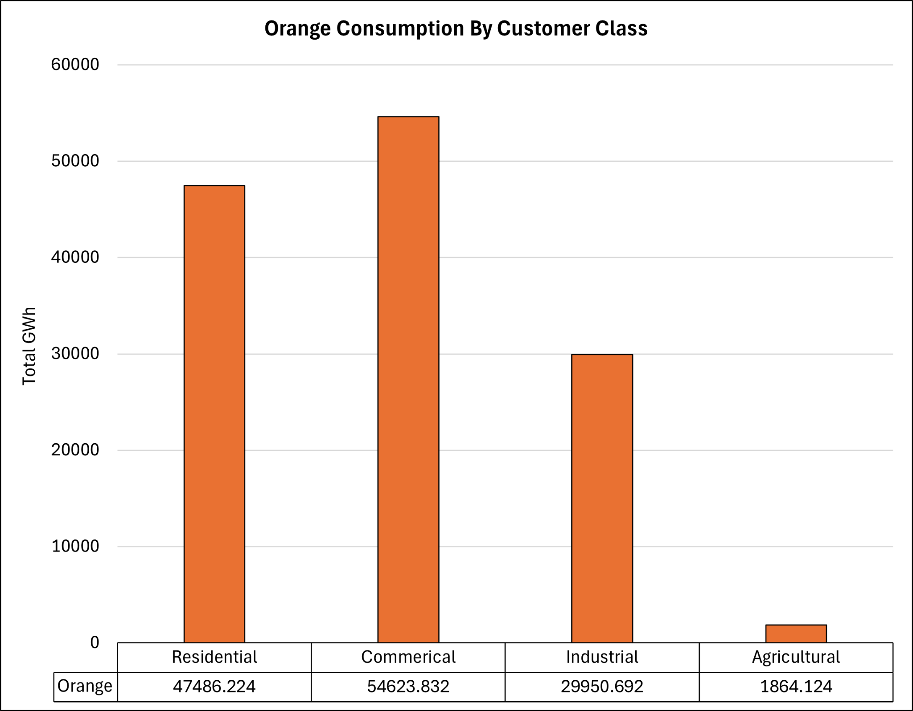

Slide 50
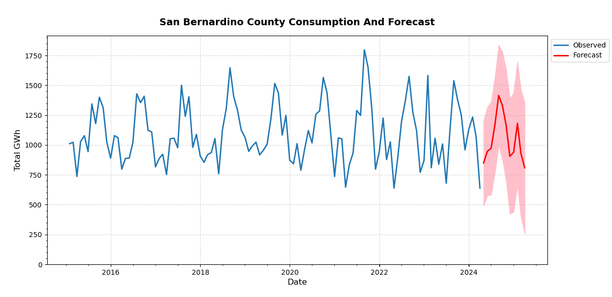
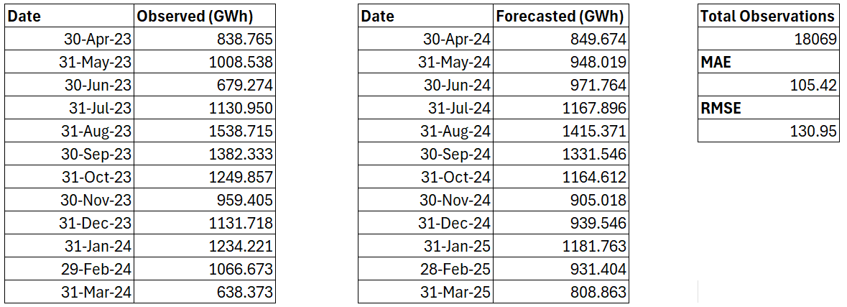
Total Observed | 12,858.82
Total Forecasted | 12,615.48
Difference | - 1.89 %

Slide 51
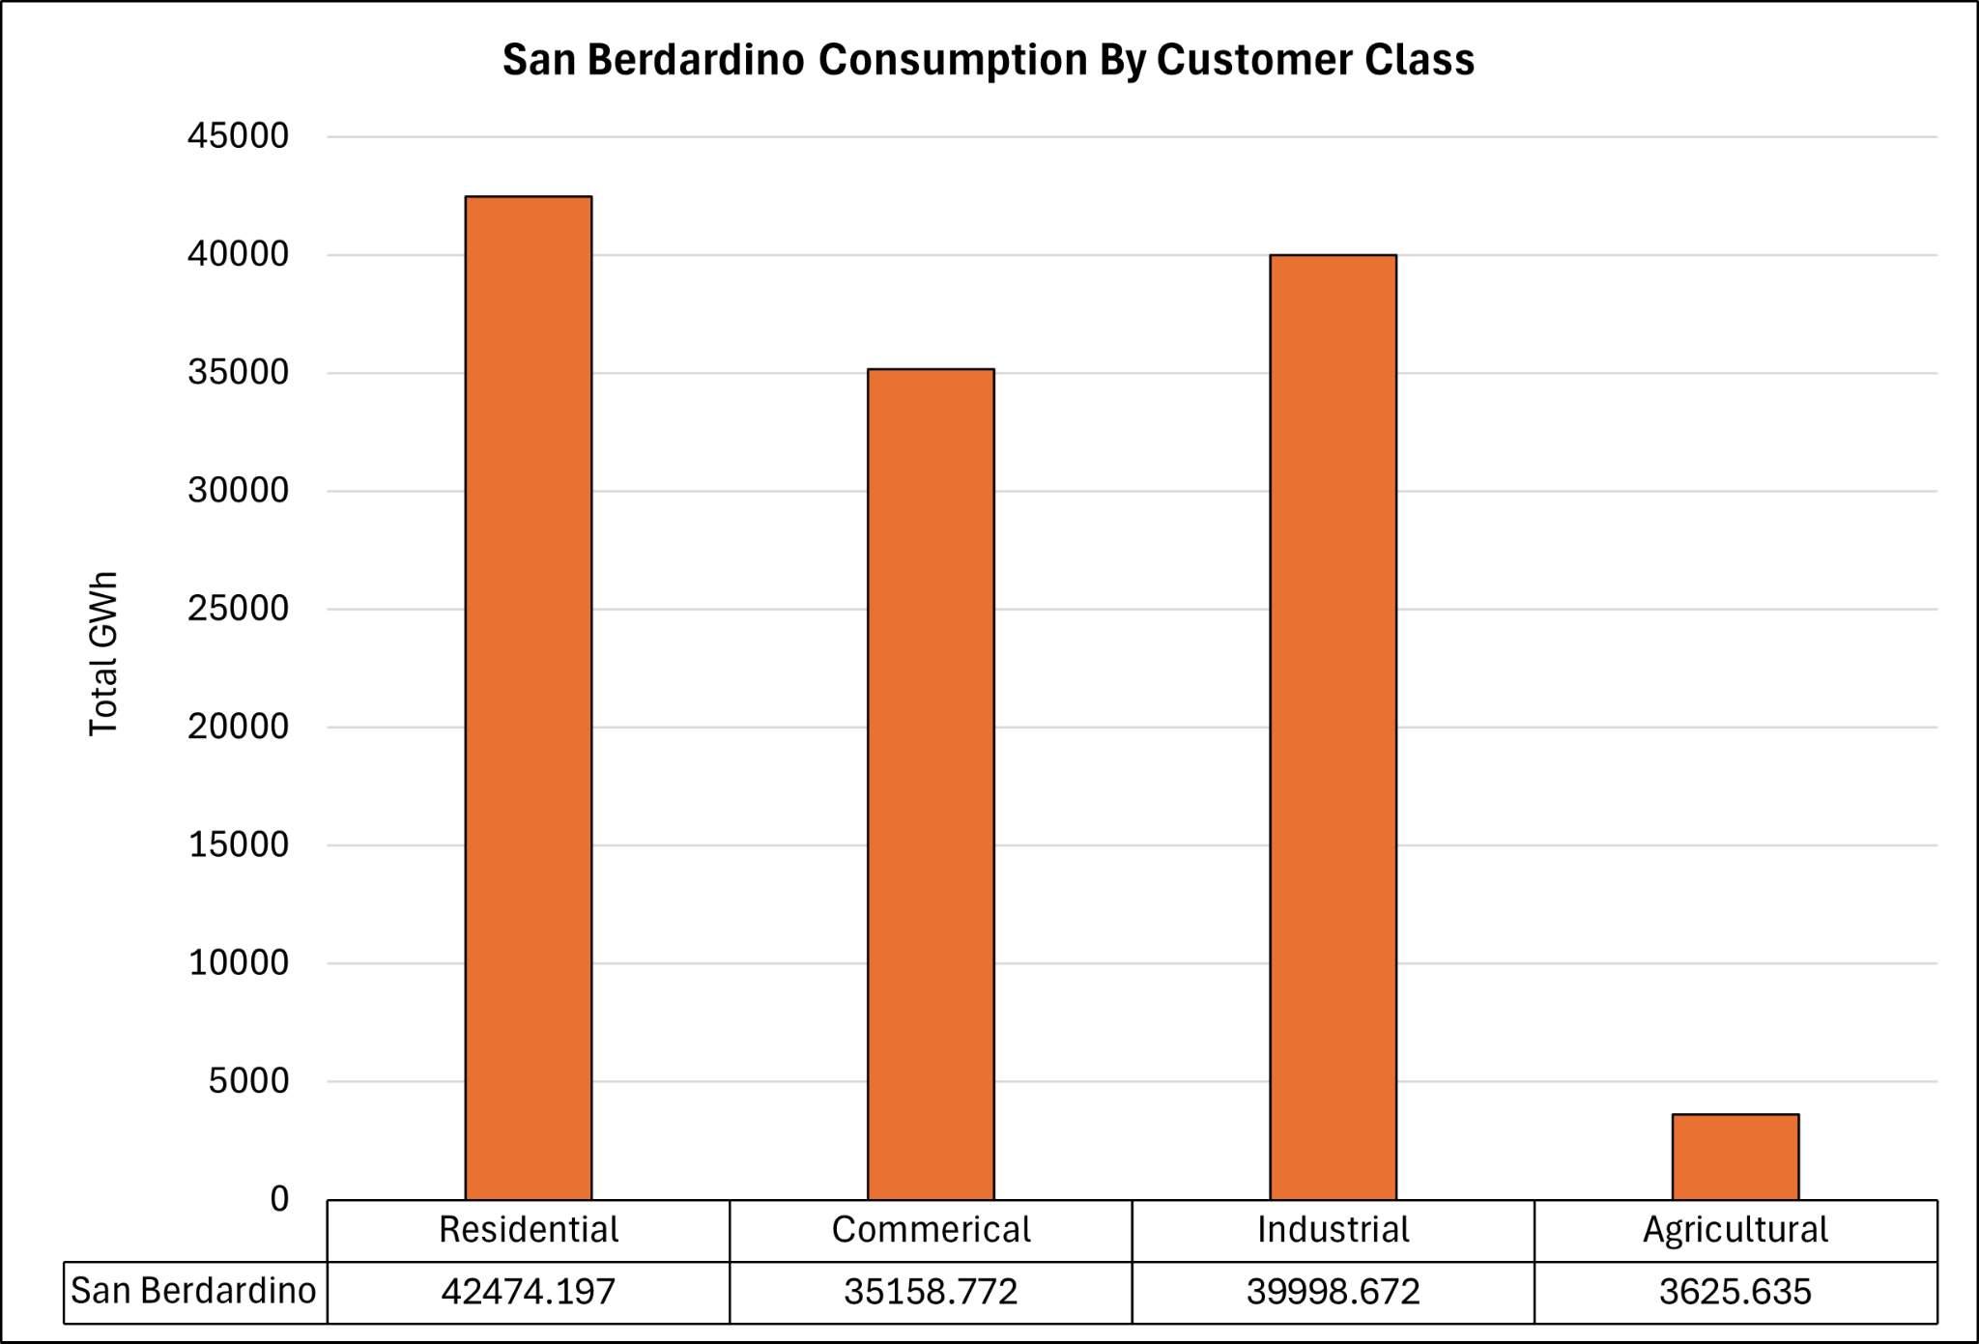

Slide 52
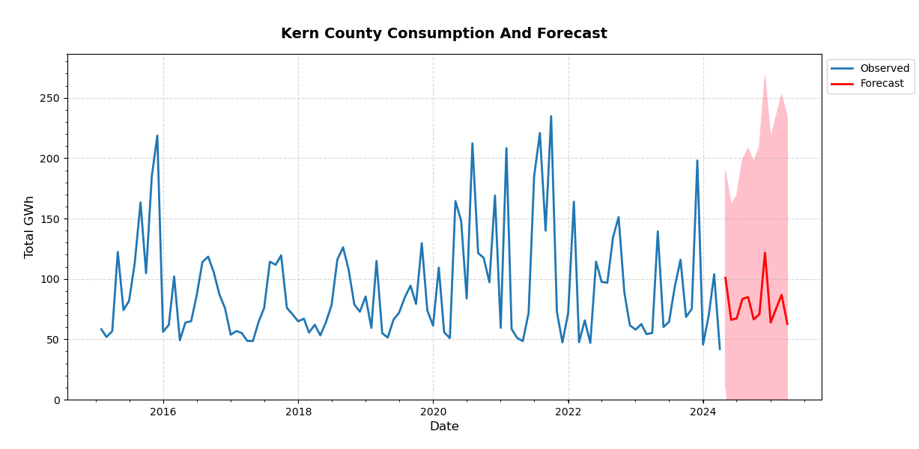
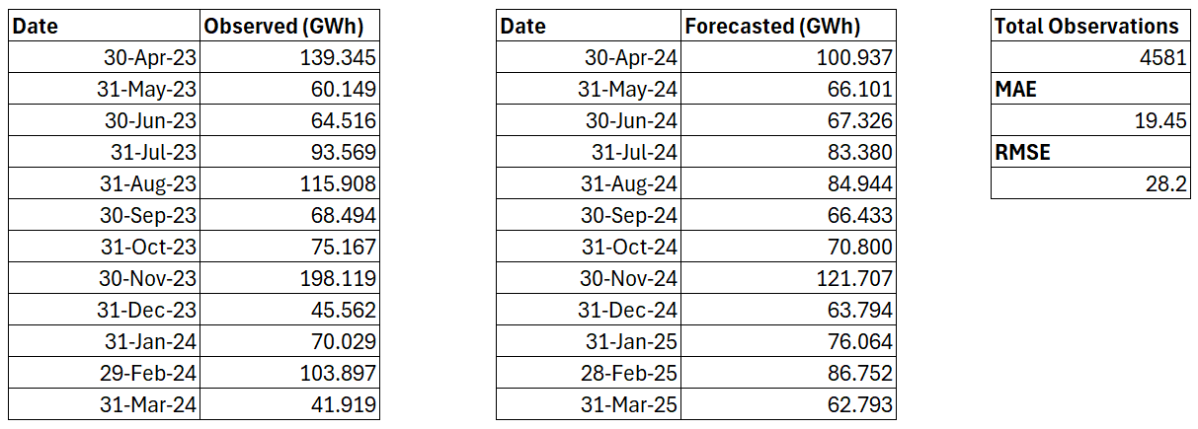
Total Observed | 1,076.68
Total Forecasted | 951.03
Difference (%) | - 11.67

Slide 53
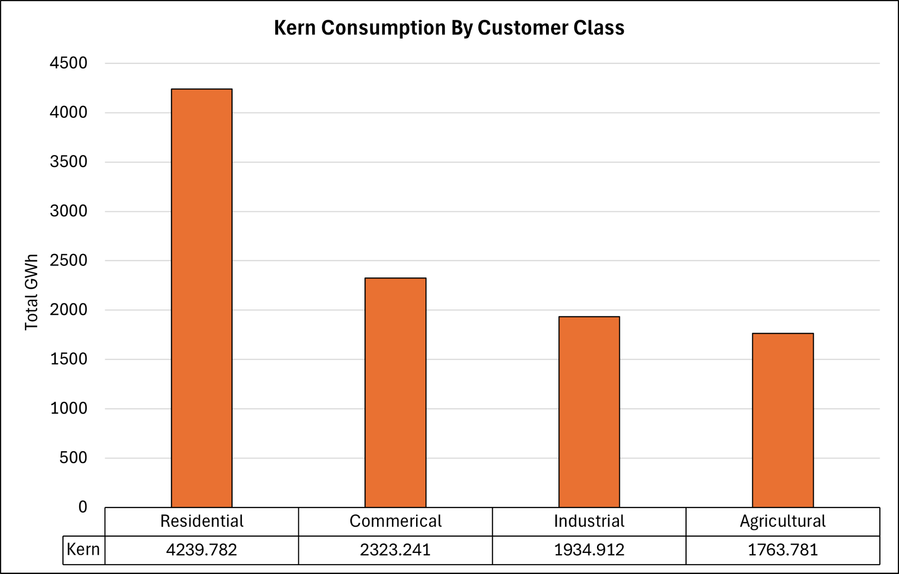

Slide 54
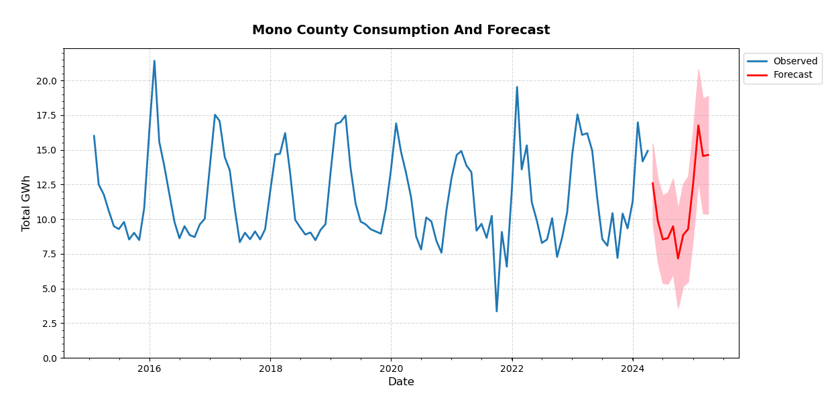
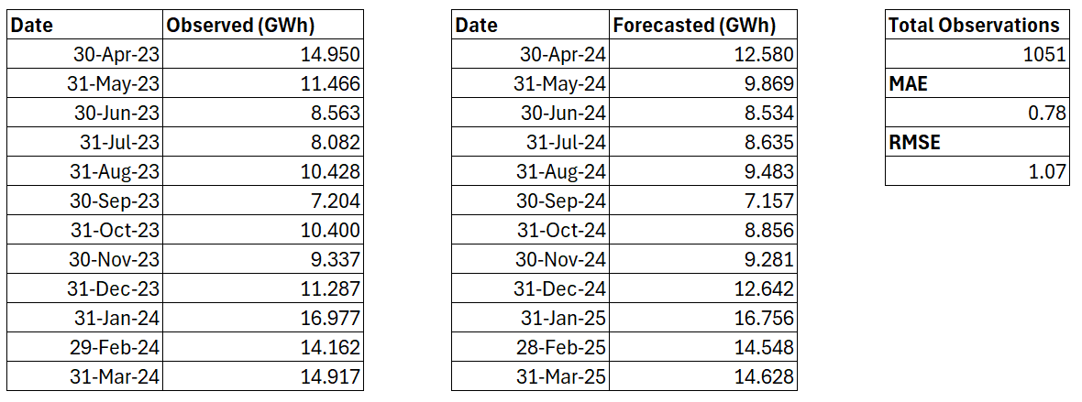
Total Observed | 137.77
Total Forecasted | 132.97
Difference | - 3.49 %

Slide 55
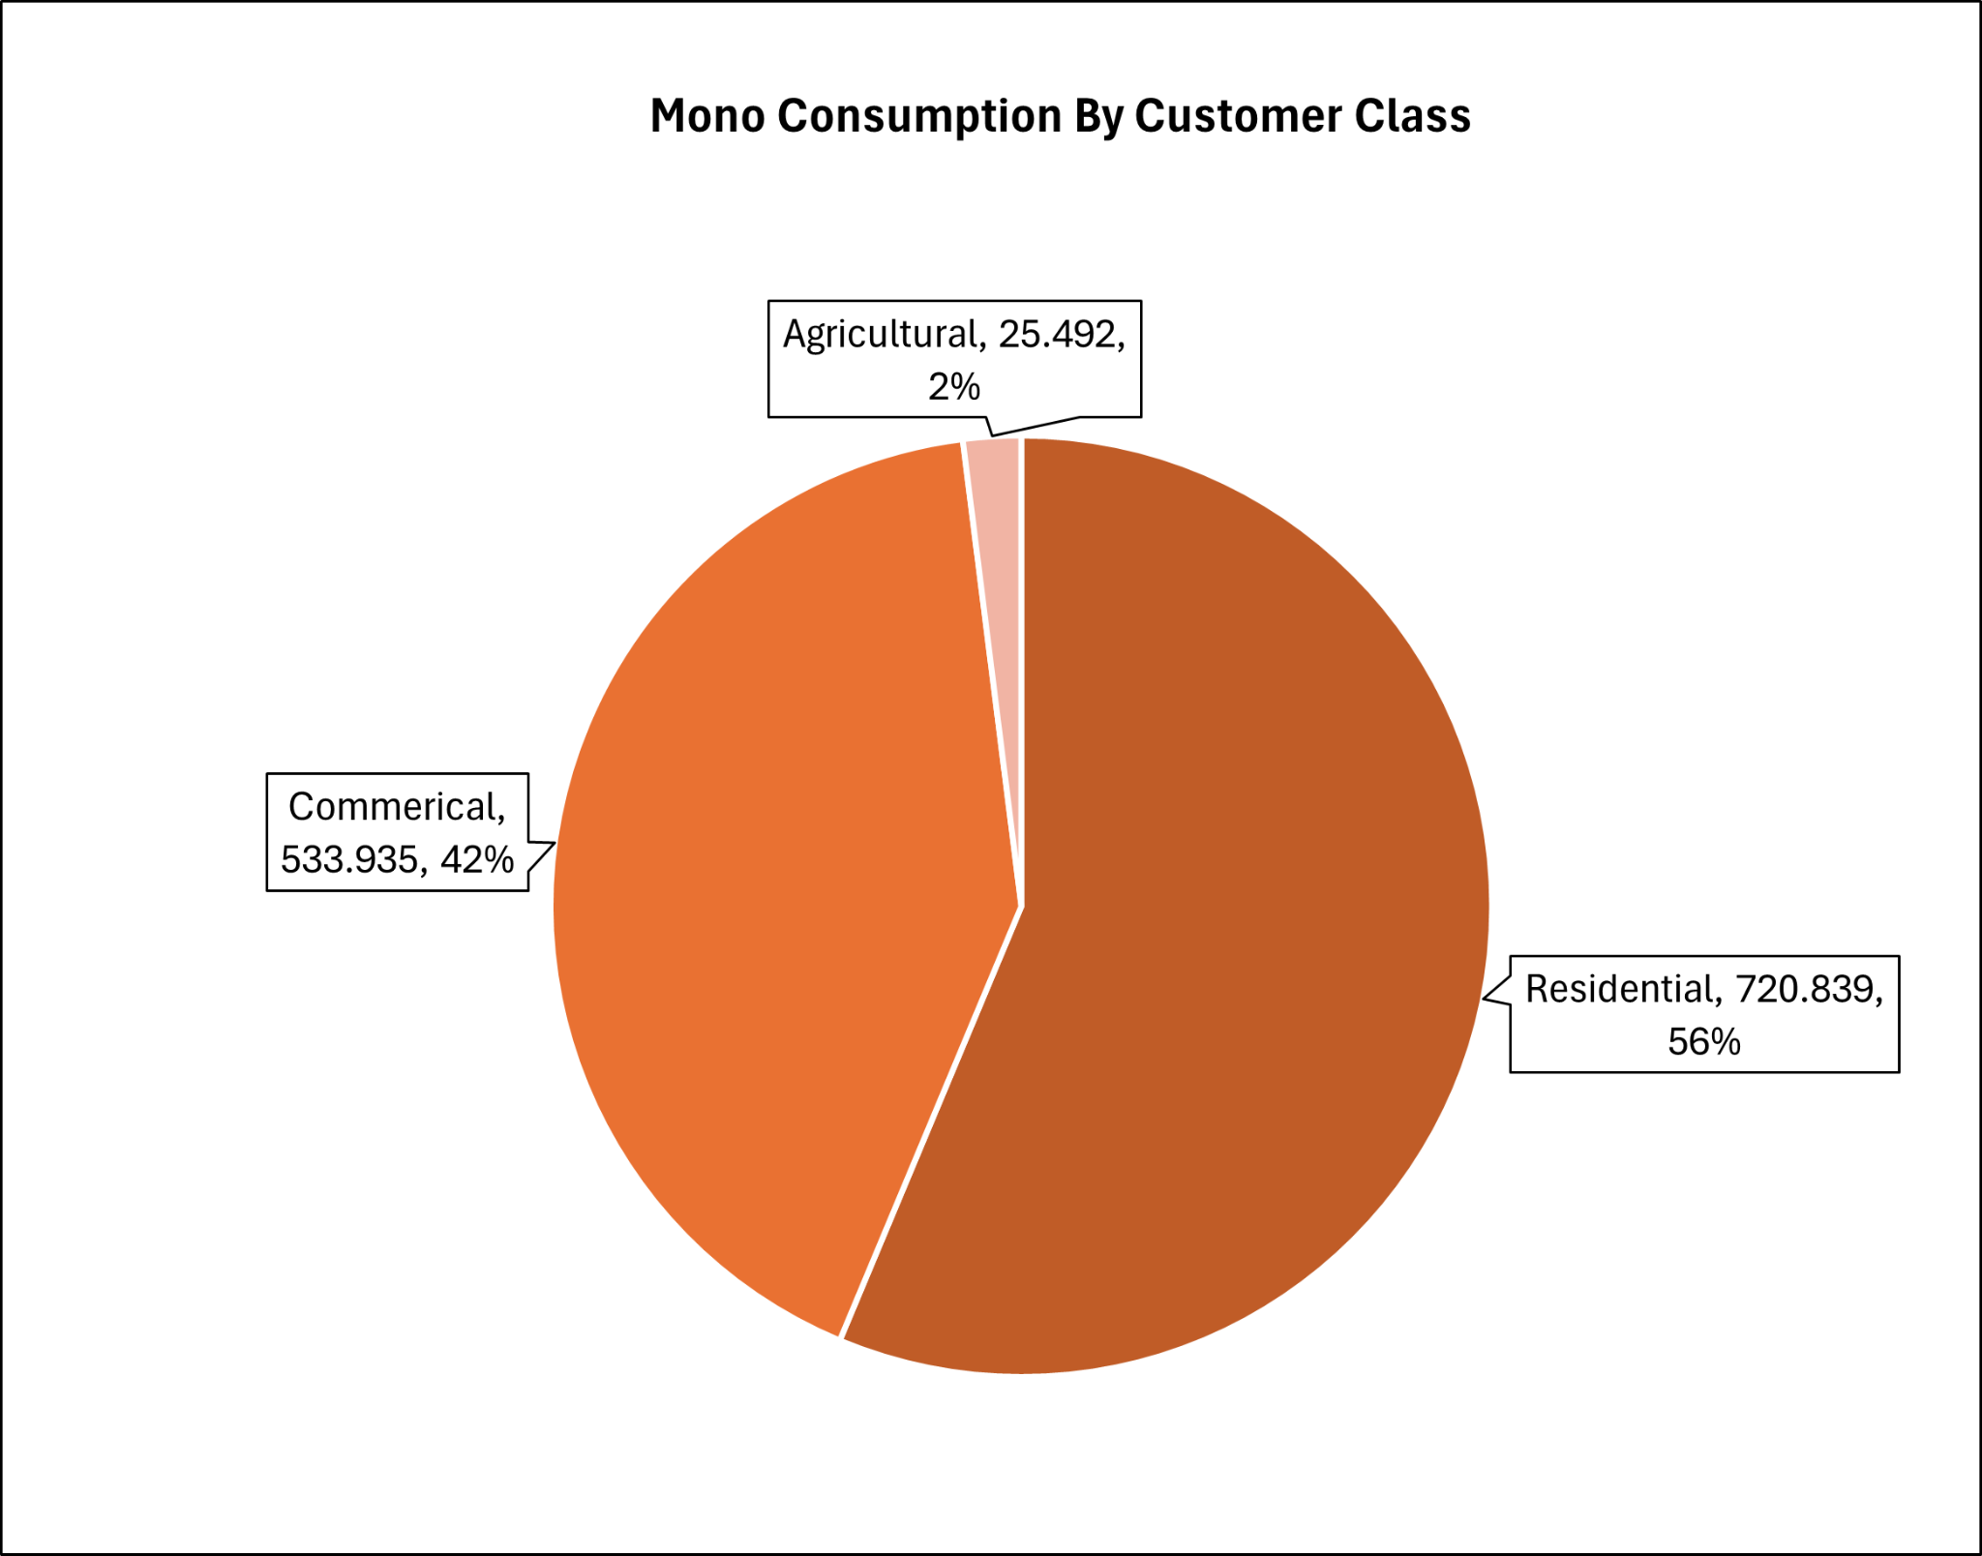

Slide 56
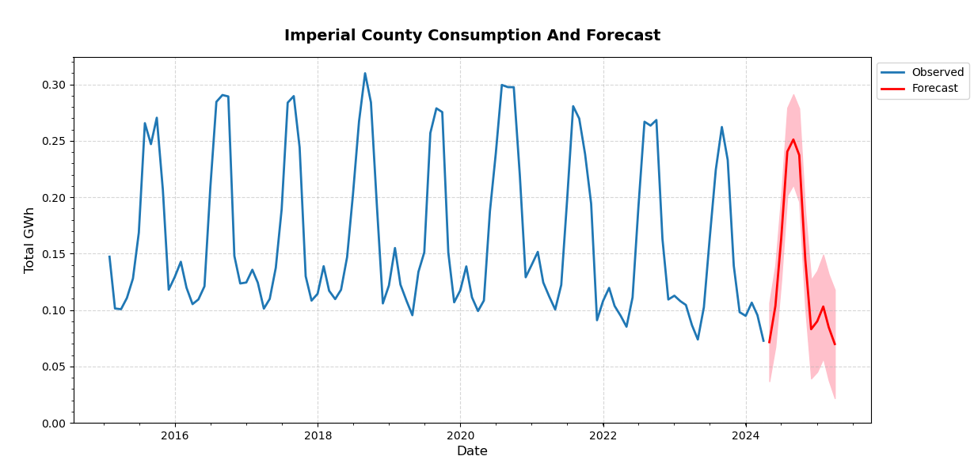
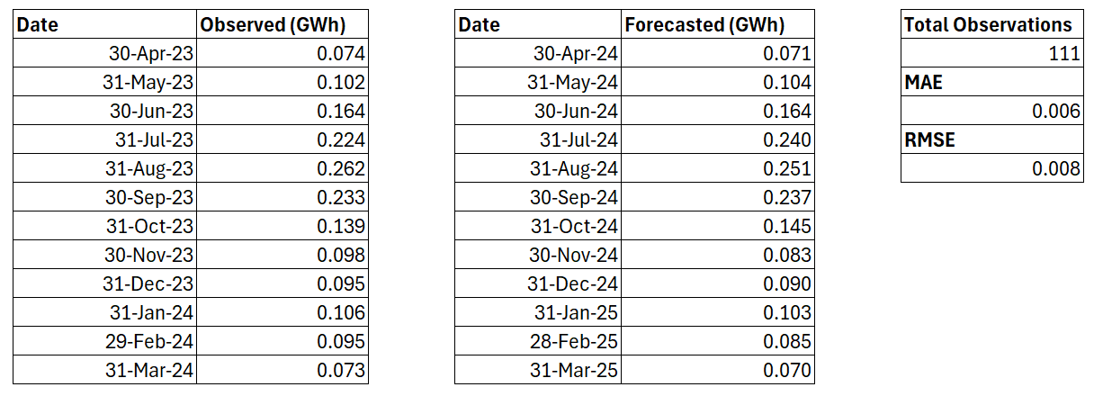
Total Observed | 1.67
Total Forecasted | 1.64
Difference | - 1.41 %

Slide 57
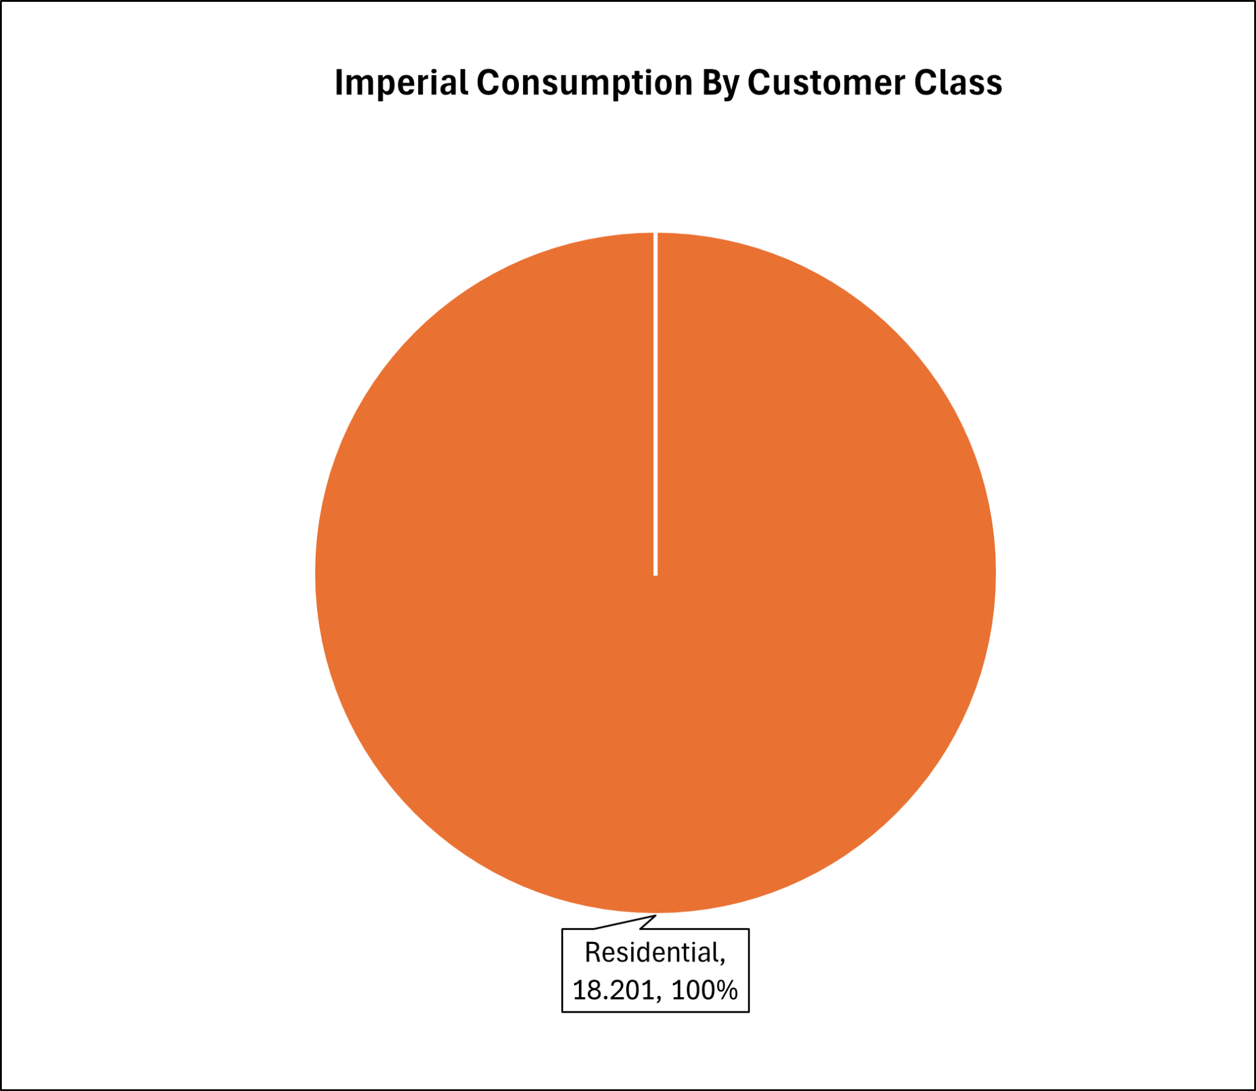

Slide 58
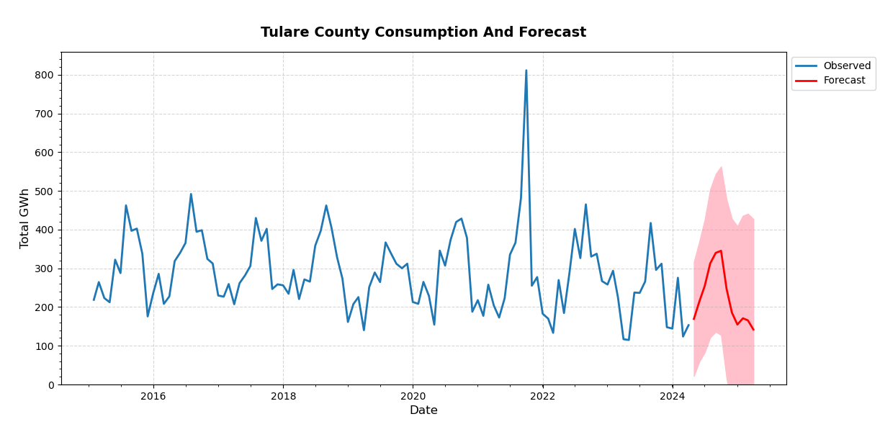
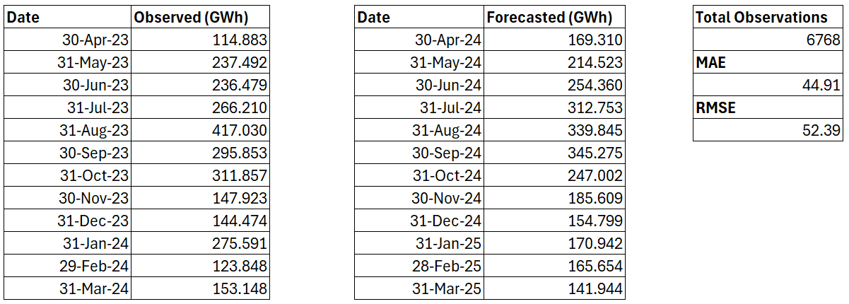
Total Observed | 2,724.79
Total Forecasted | 2,702.02
Difference | - 0.84 %

Slide 59
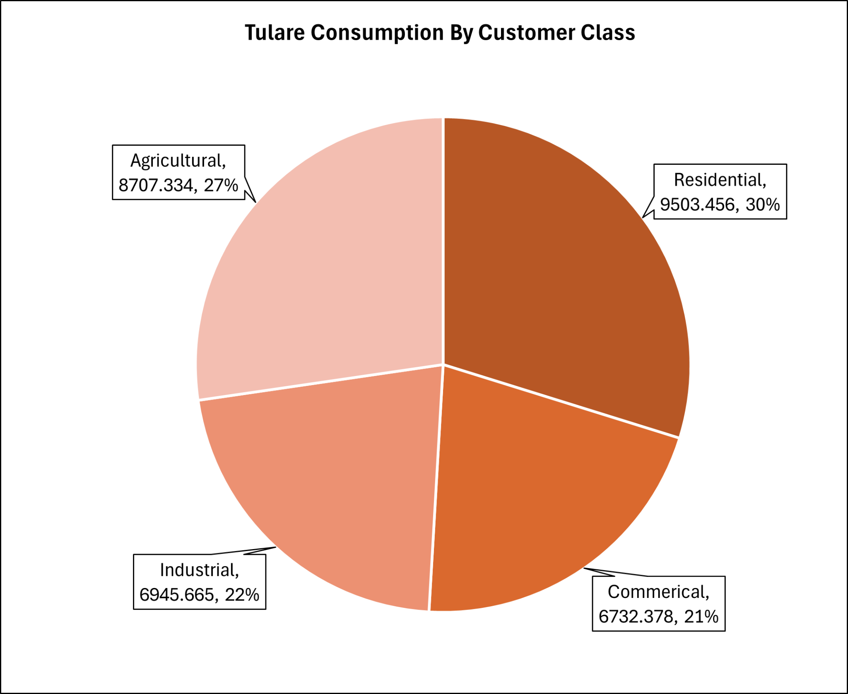

Slide 60
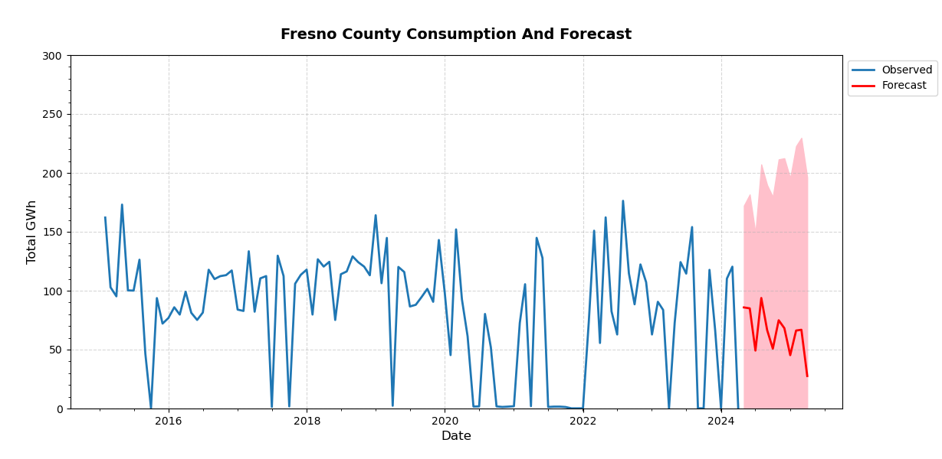
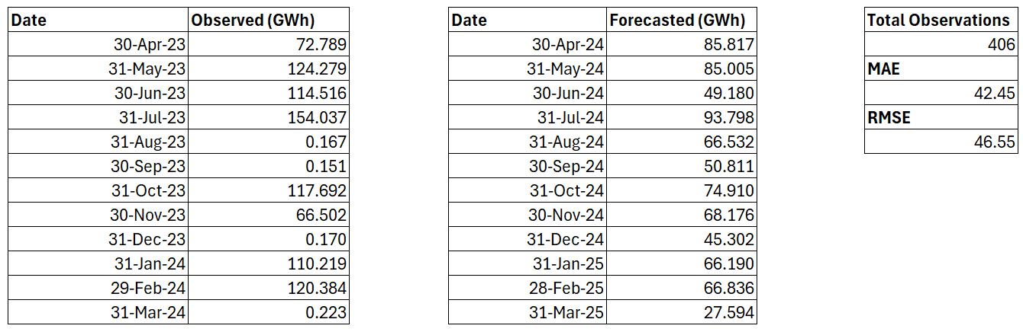
Total Observed | 881.13
Total Forecasted | 780.15
Difference | - 11.46 %

Slide 61
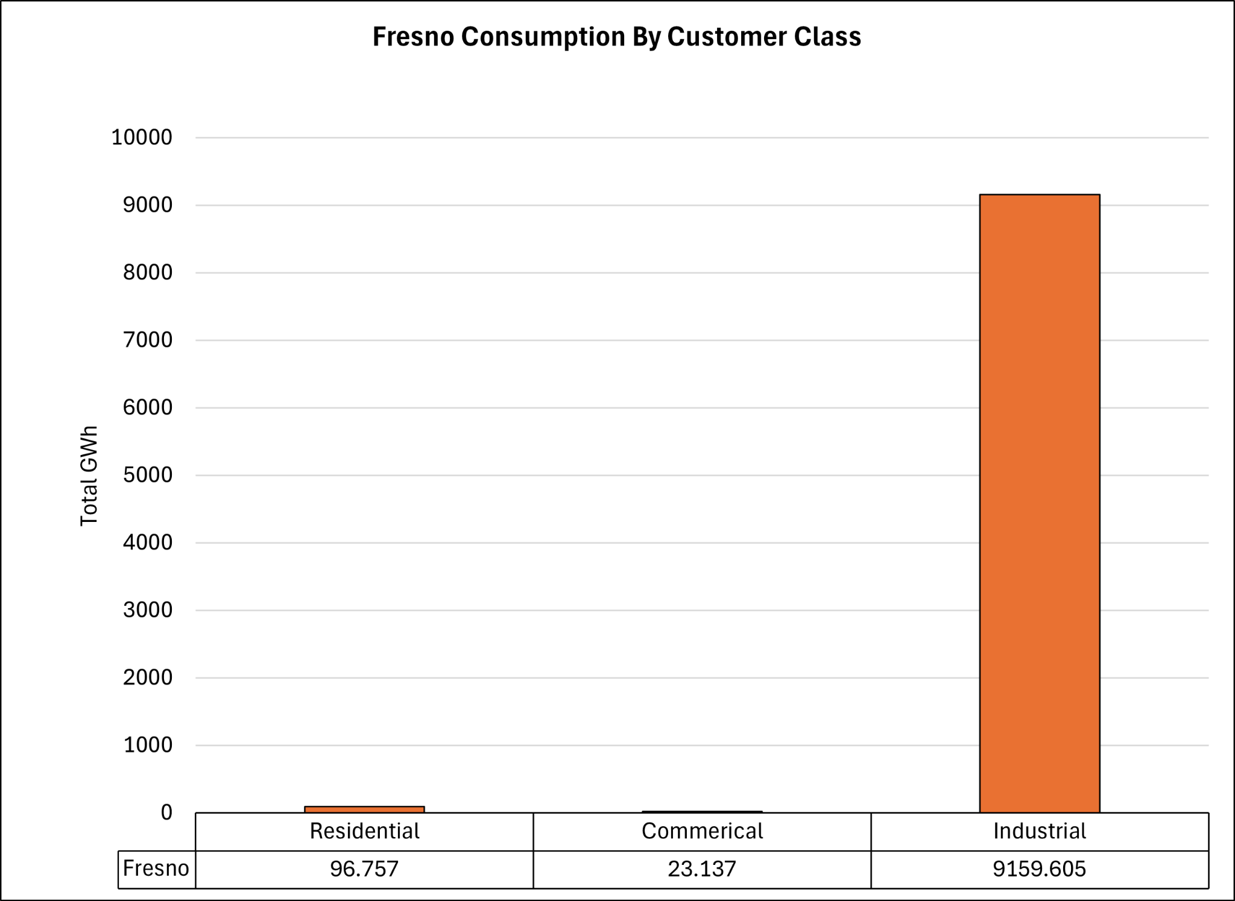

Slide 62
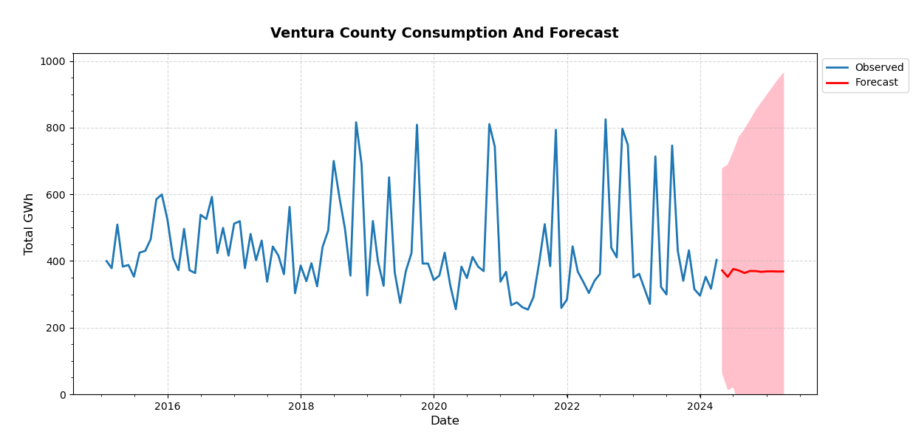
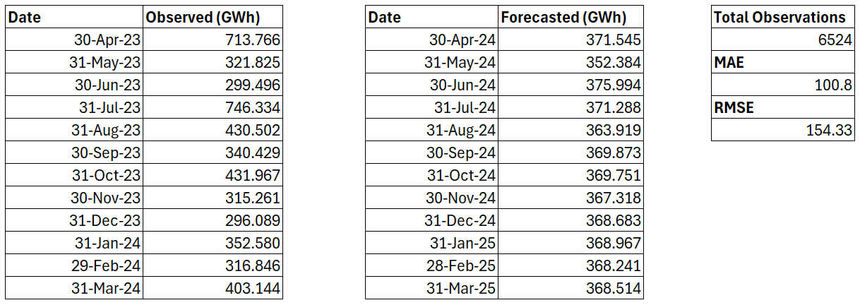
Total Observed | 4,968.24
Total Forecasted | 4,416.48
Difference | - 11.11 %

Slide 63


Slide 64

Madera County
Not Enough Data

Slide 65
Limitations Possibly Affecting Models
Limited Historical Data
Scope
Drastic Seasonality
Unpredictable Events

Slide 66
Resource Allocation Strategies
Involves optimizing operational processes, enhancing customer service, adopting innovative technologies, and promoting sustainability

Slide 67

Data-Driven Decision Making
Use data analytics tools to collect and analyze data on consumption patterns, peak demand time, and customers’ preferences
Predictive analytics to forecast future demand and identify areas for resource optimization
Real-time monitoring systems could help respond to fluctuations in supply and demand

Slide 68

Sustainability Initiatives
Create sustainability goals and include targets for reducing greenhouse gas emissions, increasing renewable energy capacity, and promoting energy efficiency
Interact with stakeholders to support and align with sustainability efforts

Slide 69
Regulatory Compliance and Risk Management
Requirements
Mitigating Risk
Stay up to date on energy regulation utilities and addresses risks and limitations
Plans related to supply chain disruptions, cyber threats, and natural disasters should be prepared
Notes:
Abhi

Slide 70
Infrastructure Investment
Renewables
Technologies
Distribution
Prioritize investments in renewables to diversify the energy mix and reduce reliance on fossil fuels
Invest in smart grid technologies like advanced metering infrastructure (AMI) and distribution automation, to enable remote monitoring and control of energy distribution
Upgrade transmission and distribution networks to improve efficiency, reliability, and resilience against extreme weather events and cyber threats

Slide 71


Energy Storage Solutions
Battery Storage Solutions:
Lithium-Ion Batteries:
high energy density,fast response times, scalable.
Better for smaller scale projects (residential, commercial, or industrial)
Flow Batteries (vanadium redox):
long cycle life and scalable.
Better for larger scale projects (Grid-scale)
Pumped Hydro Storage Solutions:
Existing Reservoirs:
leverage existing reservoirs and hydroelectric facilities for pumped hydro storage.
New Pumped Storage Projects:
constructing new reservoirs or repurposing existing infrastructure to create a closed-loop pumped hydro storage system.
Significant cost implications

Slide 72
Continuous Improvement
Internal Culture Development:
Actively seek feedback from employees
Use suggestion boxes, forums, and recognition programs
Incentivize and reward innovative ideas and contributions
Cross-Sector Collaboration:
Collaborate with research institutions, universities, and startups
Exchange ideas, share knowledge, and collaborate on research and develop initiatives
Training and Development:
Invest in training and development programs to enhance employees
Provide workshops, seminars, and conferences focus on the and emerging technology within the energy industry
Data-Decision Making:
Leverage data analytics, machine learning, and predictive modeling techniques to identify opportunities for optimization and efficiency improvement.

Slide 73
Energy-Saving Initiatives
Designing customized energy-saving initiatives for high electricity consumption areas involves a multifaceted approach

Slide 74
Data Analysis & Assessment
Data Collection
Assessment
Collect data on target areas for energy consumption including residential, commercial, and industrial sectors
Identify peak times of energy consumption, major factors to the latter, and areas with most potential to improve

Slide 75
Demand Response & Time-of-Use Pricing
Implement demand response programs to incentivize participants in targeted areas to reduce electricity usage during peak demand periods
Time-of-use pricing plans that encourage customers to shift energy-intensive activities to off-peak hours would reduce strain on the grid and lower energy costs

Slide 76


Incentive Programs
Encourage adoption of energy-efficient technologies
Make sure incentives match the needs and preferences of target demographic such as income level, property household, & customer class

Slide 77

Technology Integration
Introduce energy-efficient technologies such as LED lighting, smart thermostats, and energy-efficient appliances through subsidized or discounted programs
Provide training and support for the installation, operation, and maintenance of these technologies to ensure maximum effectiveness.

Slide 78
Policy Support
Advocacy
What does it include?
Get support for policies at local, regional, and national levels to create an enabling environment for energy conservation
Building codes that mandate energy-efficient construction standards, incentives for renewable energy adoption, or demand-side

Slide 79

Monitoring Feedback
Implement real-time monitoring of energy consumption and savings systems to track effectiveness
Provide feedback to participants and stakeholders on energy usage and savings to determine successes and areas for improvement

Slide 80
Business Energy Assessments & Incentives
Offer financial incentives, rebates, or low-interest loans to businesses for implementing energy-saving measures such as lighting upgrades, equipment optimizations, and building envelope improvements.
Partner with local businesses to conduct energy assessments and identify opportunities for efficiency improvements

Slide 81
Community Education and Workshops
1
2
Identify High Consumption Areas: Conduct an analysis to identify areas with high energy consumption, such as neighborhoods with older buildings or commercial districts with large energy usage.
Tailored Workshop Content:
Develop workshop content addressing the specific energy efficiency needs of each identified area. For example, if a neighborhood has many older homes, focus on topics like weatherization and insulation.
3
Collaboration with Local Organizations:
Partner with local community centers, schools, or environmental organizations to host workshops in accessible locations.
4
Multilingual Resources:
Translate educational materials into multiple languages spoken in the community to ensure inclusivity and accessibility.
5
Promotion and Outreach:
Use social media, local newspapers, and community bulletin boards to promote workshops and reach a wide audience.

Slide 82


Community Engagement and Incentive Contests
Home Energy Challenge:
Residents compete to reduce their household energy consumption.
Household with the greatest percentage reduction in energy usage compared to the previous year wins.
Prizes: cash rewards, energy-efficient appliances, recognition plaques or certificates, home energy audits
School Energy Conservation Contest:
Schools compete to reduce energy usage.
The school with the highest reduction in energy consumption per student wins.
Prizes: cash rewards, donations to charity, recognition plaques or certificates, community events, public recognition

Slide 83


Partnerships and Collaboration
Government Agency Collaborations:
Collaborate with government agencies at the local, state, and federal levels to align efforts in promoting energy efficiency, renewable energy adoption, and regulatory compliance.
Benefits: Regulatory Compliance and Support, Access to Funding and Incentives, Public Policy Advocacy
Non-Profit Organization Partnerships:
Partner with non-profit organizations focused on sustainability, energy conservation, and community development to leverage their expertise, networks, and community outreach capabilities. (Environmental Defense Fund, Sierra Club, Alliance to Save Energy)
Benefits: Access to Expertise and Resources, Expanded Reach and Community Engagement, Enhanced Credibility and Trust
Notes:
Access to Expertise and Resources: Partnering with nonprofits allows SoCal Edison to tap into their specialized knowledge, expertise, and resources in areas such as energy efficiency, renewable energy, community engagement, and environmental advocacy. This can enhance the effectiveness and impact of SoCal Edison's initiatives and programs.
Expanded Reach and Community Engagement: Nonprofit organizations often have established networks and relationships within the communities they serve. By partnering with these organizations, SoCal Edison can expand its reach and engage with a broader and more diverse audience, including underserved communities and stakeholders who may not typically interact with the utility.
Enhanced Credibility and Trust: Collaborating with reputable nonprofits can enhance SoCal Edison's credibility and trustworthiness, particularly among stakeholders who value environmental stewardship and social responsibility. This can strengthen SoCal Edison's brand reputation and foster positive relationships with customers, regulators, and the broader community.
Innovation and Collaboration Opportunities: Partnerships with nonprofits provide opportunities for innovation and collaboration on new initiatives, pilot projects, and research endeavors. By working together, SoCal Edison and nonprofit partners can develop and implement innovative solutions to energy-related challenges, driving progress towards sustainability goals.
Regulatory and Policy Support: Nonprofit organizations often play a significant role in shaping energy policy and regulatory frameworks. Collaborating with these organizations can help SoCal Edison navigate complex regulatory landscapes, advocate for favorable policies, and demonstrate its commitment to advancing environmental and social objectives.

Slide 84
THANK YOU

